Slide 1
Equity and Pedagogy are Two Sides of the Same Coin: We can’t say we care about the former without serious attention to the latter
ATOMIC Conference – January 24, 2025
Steve Leinwand
steveleinwand@gmail.com www.steveleinwand.com

Slide 2
Welcome to Math
On your white boards, write what you had for dinner last night.
Who had the “best” dinner?
Who had the weirdest dinner in your opinion?
What did we just learn?
Then in the bottom corner, write how many people you ate with at dinner last night.
About how many is the average dinner size?
How might we summarize these data?
WHY DO THIS?

Slide 3
The benefits:
Everyone has access
Low floor, higher ceiling
Linking math to a real context
From two to five minutes
SEL
Learning about your classmates and about diversity
Data
See what I mean by equity is about pedagogy?

Slide 4
Subtext:
The time to take action is now!
The time to make changes to make things much more mathematically better for our students and for our society is now!

Slide 5
Why????

Slide 6
What I see a lot of and what exacerbates equity issues:

Slide 7
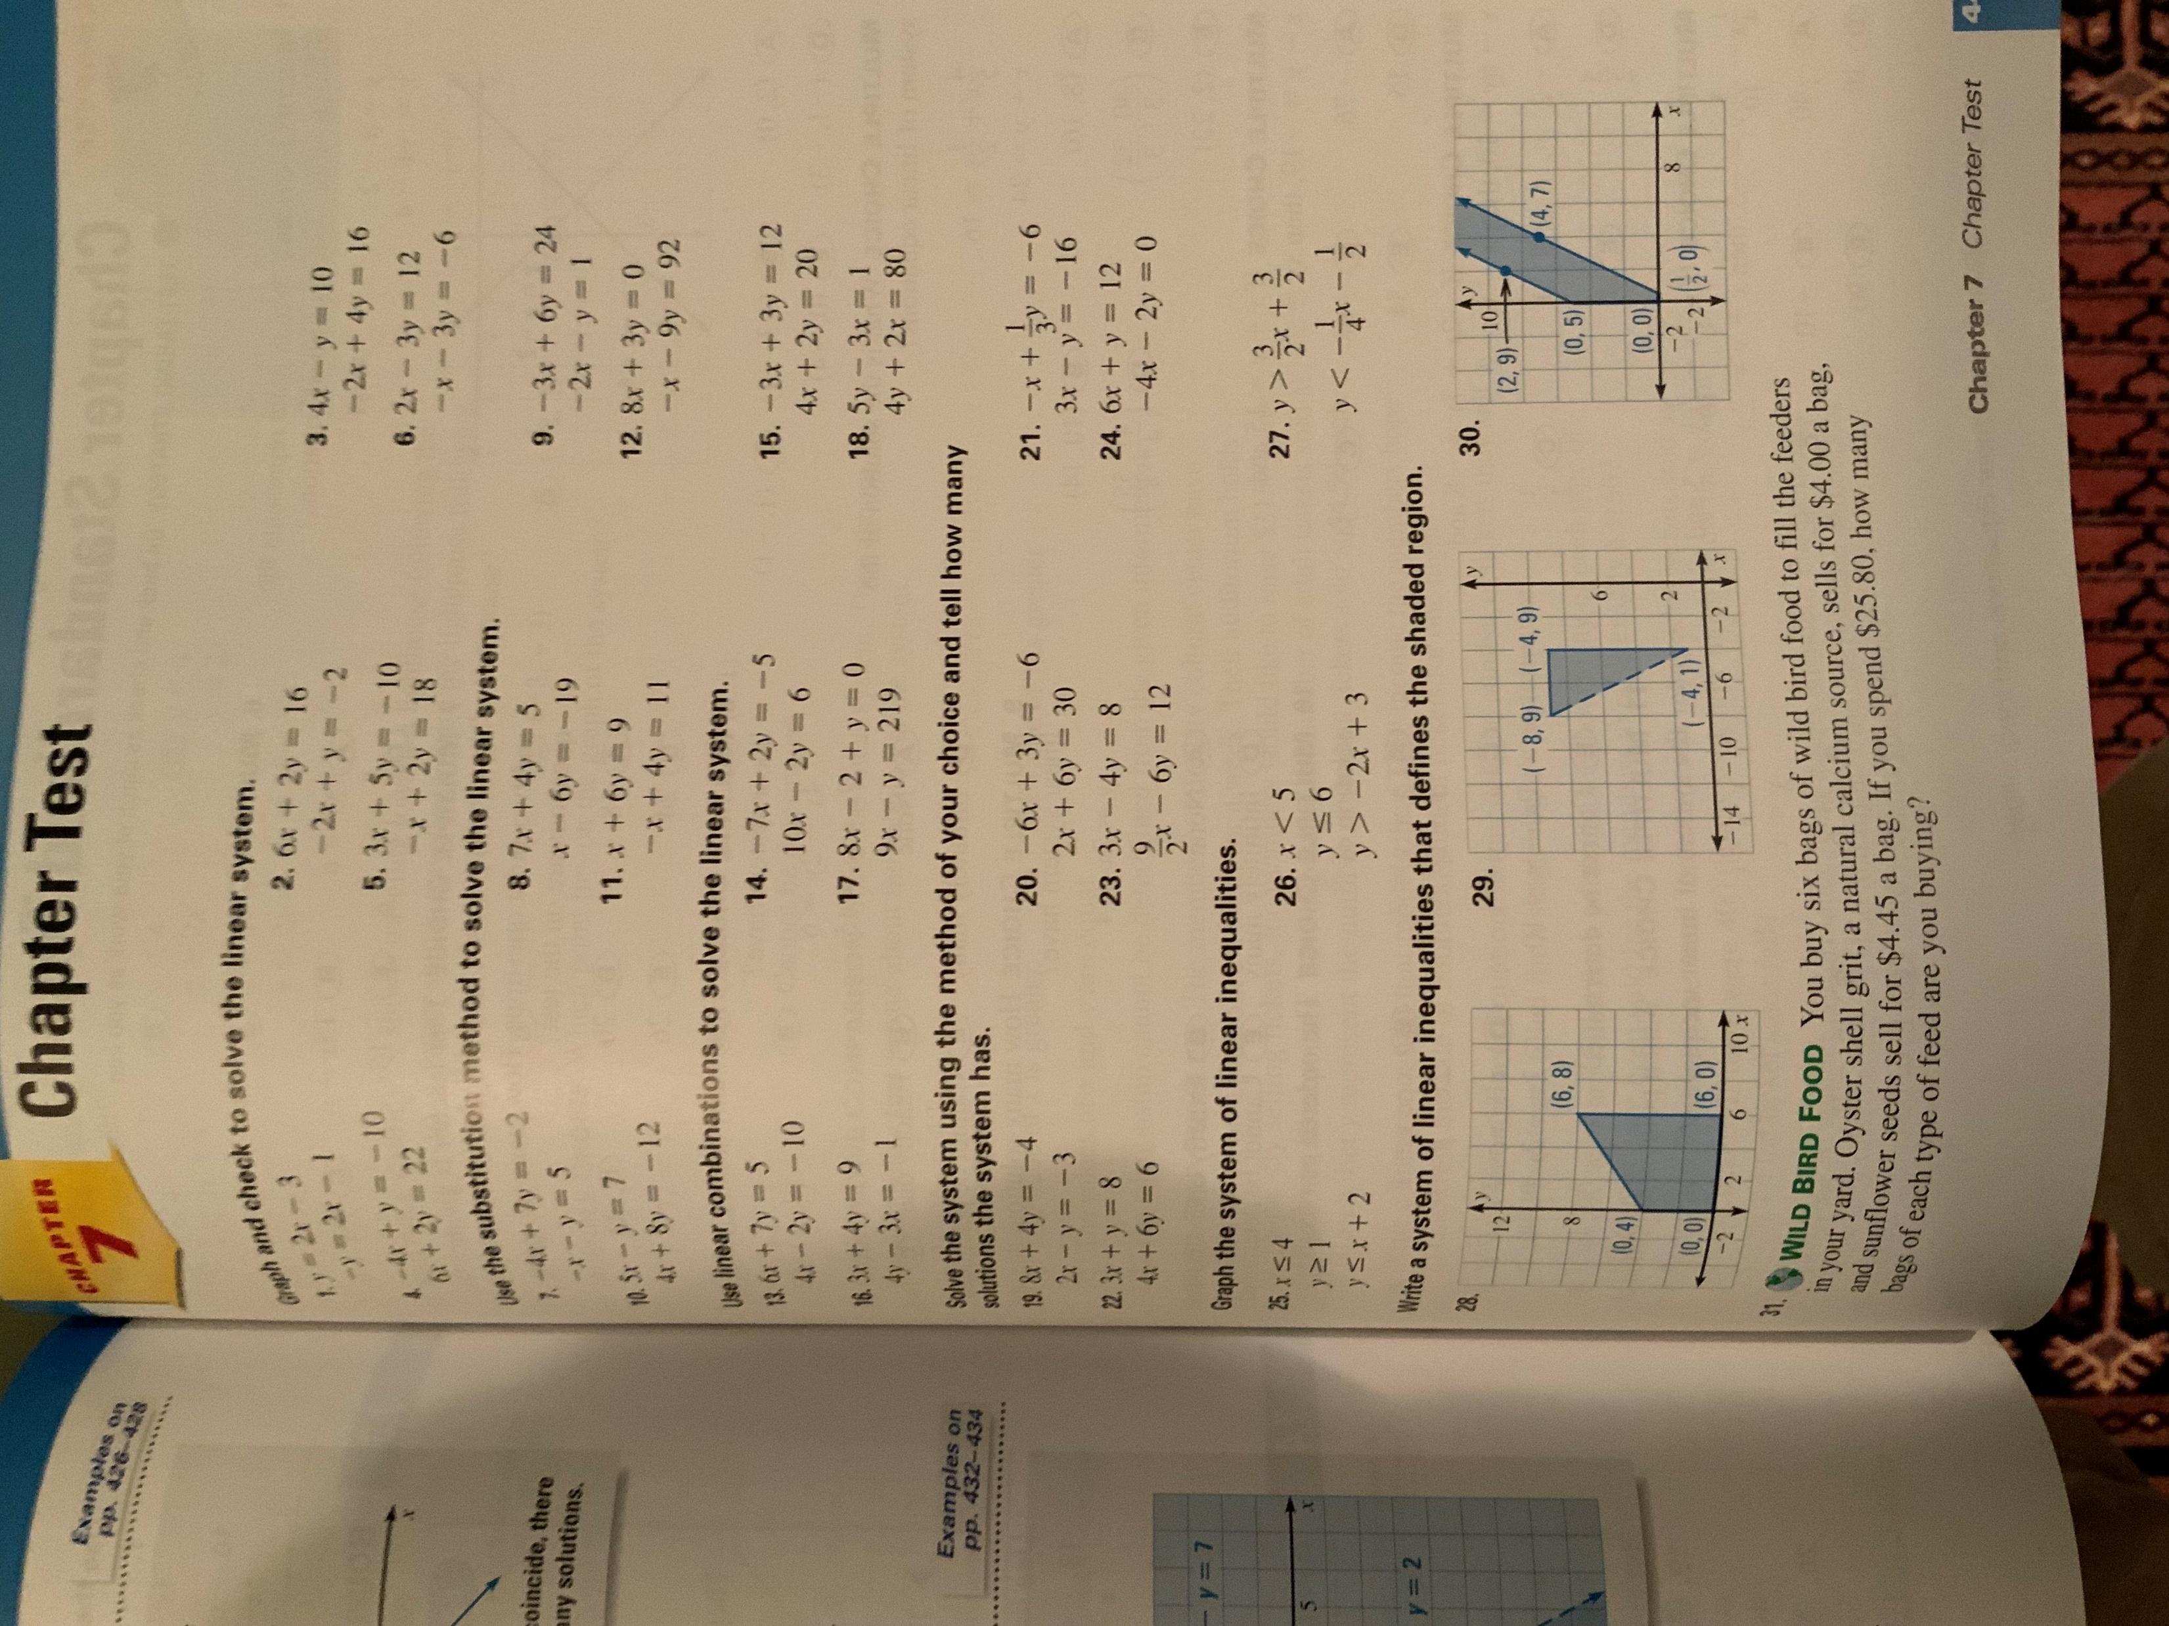
How does this humanize?
How does this invigorate?
How is this any different from the square root algorithm that no one misses?
For many it deadens.

Slide 8
Alternatively….

Slide 9
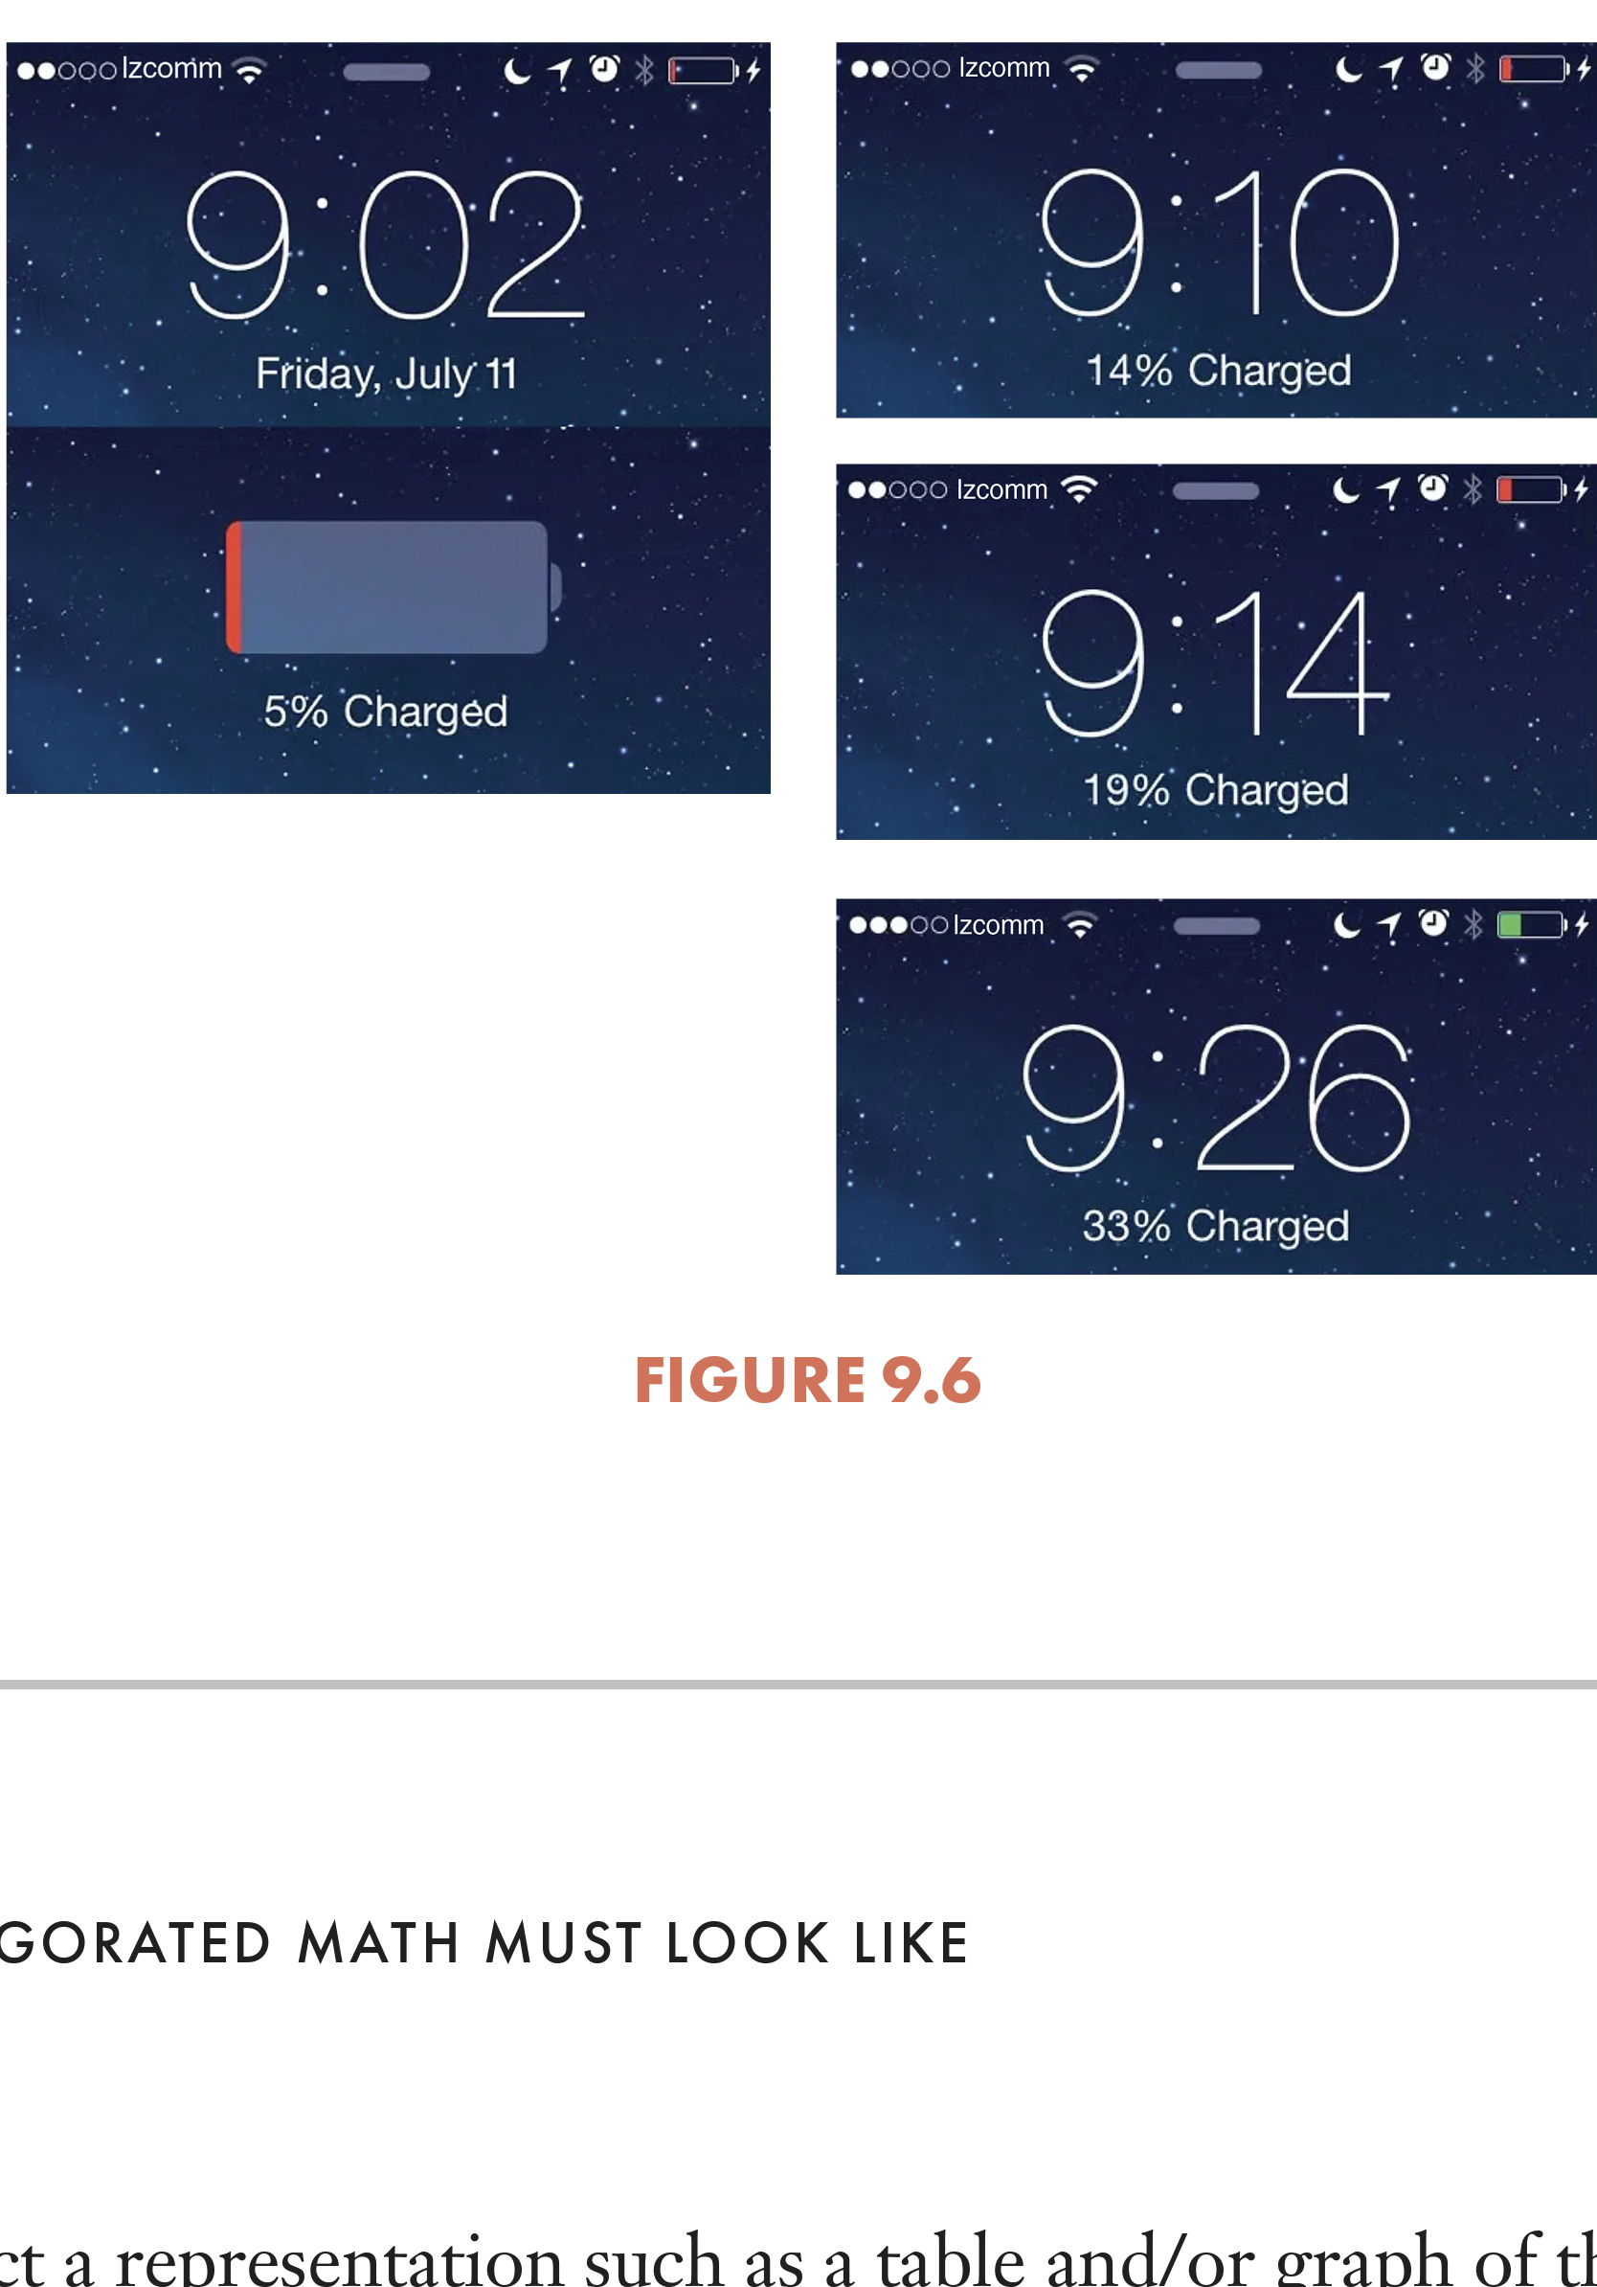
Alternatively:
It enlivens. It humanizes.
It invites interest. And it is fundamentally mathematical -
not as enrichment,
but as core instruction.

Slide 10
Powerful mindsets thanks to Francis Su
or
What needs to happen when we close our classroom doors

Slide 11
3. ­­Mathematics for Human Flourishing (adapted from Francis Su, 1/6/17 Joint Math Meetings Presidential Address)
Human Desires | Play | Beauty | Truth | Justice | Love
Virtues | Community Hopefulness Perseverance | Joy Wonder | Rigorous thinking Humility Circumspection | Dignity Equity Fairness | Compassion Empathy
Flourishing | You cannot flourish without play | You cannot flourish without the joy and wonder of beauty | You cannot flourish with falsehoods | You cannot flourish with injustice | You cannot flourish without loving and being loved
Mathematics | Math is a playground of the mind! | Math is beautiful! | Math is the essence of truth! | Math can and must create social justice! | For all these reasons, math should be loved!
Conclusion | Yes, we teach our students the skills, concepts and applications of mathematics, but we also teach human beings who possess the human desires to play, and for beauty, truth, justice and love in their lives. What a joy that mathematics, well taught and with this shift in mindset, provides such rich opportunities to meet these human desires, attend to the virtues of a live well-lived, and foster intellectual, social and emotional flourishing in and outside of our classroom.

Slide 12
Mindsets upon which to build:
Making math work for nearly all is very, very hard but must guide our work.
It’s about THEIR learning.
Their learning must include the development of self-confidence, communication skills, agency, collaboration in addition to math.
The world is changing much faster that our math curriculum which is why learning how to learn takes priority over coverage.

Slide 13
And most importantly:
Several months ago, while reading Street Data, I was called up short with the sentence: “Equity work is first and foremost pedagogical.” I’ve not read another word in the book and have been consumed by the implications of this sentence.
This morning we’ll look at some of these implications with practical examples

Slide 14
And now that I’ve set the table:
Let’s take a look at what all this means in practice.

Slide 15

What do you notice?
Omaha
244 miles
Omaha
Car Manual
Gas Tank Capacity:
21 gallons
Average MPG:
28.3

Slide 16
What might the question be?
Omaha
244 miles
Omaha
Car Manual
Gas Tank Capacity:
21 gallons
Average MPG:
28.3

Slide 17
Will you make it to Omaha? Convince us!
Omaha
244 miles
Omaha
Car Manual
Gas Tank Capacity:
21 gallons
Average MPG:
28.3

Slide 18
What made this engaging and empowering?
Omaha
244 miles
Omaha
Car Manual
Gas Tank Capacity:
21 gallons
Average MPG:
28.3

Slide 19
Your turn:
What did you notice?
What made this effective?
How might you have done it better?

Slide 20
From a task to a lesson

Slide 21
“Our goal for today is to:
“identify, create and understand equivalent expressions.”
Are you ready?

Slide 22
Number strings for today’s Mini Lesson
Are they equivalent? How do you know?
4(8) = 4(3 + 5)
4(8) = 4(a + 5)
4(8) = 4(3 + b)
3x + 3y = 3(x + y)
Let’s summarize: For each: Always, sometimes, never equivalent?

Slide 23
A Task for our Math Workshop
Jan normally rides her bike to and from work.
Her normal route is 18 miles from home to work.
One day she goes to a coffee shop on her way to work and on her way home.
This adds x miles to her trip each way.
Great: Write and show the distance Jan travels using a diagram or picture and two different, but equivalent, expressions.

Slide 24
Resulting in:
18 x
2
x 18
18 + x + 18 + x 18 x
2(18 + x)
2(x + 18)
x + x + 18 + 18
36 + 2x
“Which one is incorrect?”
“What do the numbers and variables represent?”
“Which expression is simplest or easiest to use? Why?”

Slide 25
Lesson 6 Exit Ticket
Which of the following represent equivalent expressions?
Explain or show your process of determining which expressions ARE equivalent.
If they are NOT equivalent, fix them so that they are.
a. x + x + x + x = 4x
b. 15 y + 5x = 3(5y + x)
c. 6(2 + x) = 12 + 6
d. 3(x + y) = 3x + y

Slide 26
Your turn:
What did you notice?
What made this effective?
How might you have done it better?

Slide 27
Pedagogical/Equity Lens #1
Establish mathematics goals to focus learning.
Implement tasks that promote reasoning and problem solving.
Use and connect mathematical representations.
Facilitate meaningful mathematical discourse.
Pose purposeful questions.
Build procedural fluency from conceptual understanding.
Support productive struggle in learning mathematics.
Elicit and use evidence of student thinking.

Slide 28
Pedagogical/Equity Lens #2 Elements of Quality or A Teaching Crib Sheet
Clarity of goals (not Lesson 4.5 or pages 214-217)
Context (not naked)
Rich tasks (not exercises)
Focused intentional questions (not punting)
Opportunities for discourse (not just telling)
Gradual release (not just a dumping)
Multiple representations (not one way)
Alternative approaches (not one way)
Explanations and justifications (not just answers)
Common errors and misconceptions (not just right correct approaches)
Sense-making by students (not lecture)
Evidence (not I taught it and let the chips….)

Slide 29
Pedagogical/Equity Lens #3 Nine Generic Questions
1. Why is that? (Who can give a different reason?)
2. Can you explain your thinking? (Who can explain it differently?)
3. Can you convince the class? (Who can convince us in a different way?)
4. How did your brain picture that? (Who pictured it differently?)
5. How do you know that? (Is there another way?)
6. How are they similar?
7. How are they different?
8. What do you notice?
9. What do you wonder?

Slide 30
Accordingly:
Don’t let anyone tell you we don’t know what to do
Don’t let anyone tell you that it can’t be done in every school
Don’t let anyone blame the kids and their families or their color or their income
Don’t let anyone tell you it takes billions more dollars
Because I’ve been in schools that show it can be done

Slide 31
Let’s dig deeper and see exactly how equity goals are met with good pedagogy and what effective teachers do to shift pedagogy and simultaneously enhance equity and the opportunity to learn?

Slide 32
1. We start with a school or district vision of effective instruction
We incorporate the NCTM Mathematics Teaching Practices
We define quality
We include what teachers should NOT be doing
We use the vision for hiring, supervision, coaching and evalution.

Slide 33
2. We outlaw (and shame) worksheet abuse, mad-minute, math sprints
Just read Jo Boaler’s YouCubed “Fluency Without Fear.”
Just look at the damage done when the focus is exclusively on speed and right answers.
Just look at how much time is wasted teaching with no feedback beyond right right wrong right wrong right.

Slide 34
Effective, equity-minded teachers:
Widely distribute “Fluency without Fear” and make it school and district policy.
Shame teachers who ignore the policy.
Model more effective forms of practice that provide feedback, limit exercises to 4 at a time, focus on alternative approaches, multiple representations and student explanations.

Slide 35
3. We are adamant that 58 minutes/day for math is the absolute minimum EVER.
Watch me: kids in rows 47 minute period
I rush. I get shrill. I watch the clock. I cut corners. I fail to be responsive to students.
Then watch me: kids in groups of 3 or 4 60 minutes
All the difference in the world – time for cumulative review or number talk, time for an exit ticket, time to think, time to use lesson chunks.

Slide 36
Effective, equity-minded teachers:
When asked:
“Why aren’t our math scores higher?”
“Why are do many students more being more successful?”
Non-compliant leaders respond:
“Simple. Our kids and teachers are cheated by anything less than 60 minutes given the district/state curriculum.”
And then we compromise at 58.

Slide 37
4. We build a system of second chances
Why are we so driven by one chance tests?
Why aren’t their widespread retesting policies for all students for every unit assessment?

Slide 38
Effective, equity-minded teachers:
Create systems of Form A and cloned Form B for every unit assessment and mandate that every student has a chance (on his or her own time) to retake every assessment within 10 school days.
Start with one elementary school, one middle school and one high school!!

Slide 39
5. We shift homework from busy work to formative assessment
There is little that wastes more time in students’ lives, in class and at home, than assigning, completing and reviewing math homework.
We spend precious minutes assigning homework and expecting our student to copy the assignment down.
We expect students to spend between 30 and 45 minutes each school night except Friday doing homework, usually regurgitating procedures and mimicking from notes and text.
We spend somewhere between 10 and 20 minutes “going over the homework” in class.
A typical assignment:
247 243 239
1-19 odd 2-20 even 32, 34, 38
All for what real value?

Slide 40
The heart of the homework matter:
If the point of homework is to see if students “get it,” then 5 practice problems is enough.
If kids get it after 5 problems, and you ask them to do another 35, you’re just being mean.
And if kids don’t get it after 5 problems, and you ask them to do another 35, you’re really being mean.
- Matt Cwalina, Discovery Education

Slide 41
Effective, equity-minded teachers:advocate for sensible 2-4-2 HW
2 problems on the new skill (which is usually enough to determine understanding and avoids such much practice of mistakes that it is hard to unlearn them);
4 cumulative review problems roughly drawn from the day before, the week before, last month and perhaps a diagnostic readiness check for the next lesson - all of which honor distributive practice; and
2 problems that require showing work or explanation and support problem solving and reasoning and justification.
After beginning mathematics the next day, teachers can easily post the answers to these 8 exercises or problems on the white board and provide students with 5 minutes to review their work in pairs or triads with particular attention to the last two problems. Classroom policy can then be that correct work for any problems that are still causing trouble can be easily displayed with a document camera and discussed before homework is collected, only to be recorded as completed.

Slide 42
6. We recognize technology as a right and an essential learning tool
The lack of access, the inequity, the unfairness and the variations from classroom to classroom when it comes to technology is a scar on all of us – and we know it.
Technology is a great place to explore access, or lack of access, and its often highly inequitable distribution.

Slide 43
Effective, equity-minded teachers:
Take SMP #5 seriously: Use appropriate tools strategically.
Notes and slides on an accessible site for students
Computer delivered assessments
Cell phones
Three-act lessons
Programs like Illustrative Math and Desmos

Slide 44
7. We demand a focus on real Professional Development
Common sense, research-affirmed PD practices that :
help us envision the shifts
address beliefs and mindsets
link opportunities for practice and feedback
involve collaborative work
As opposed to after-school, one-shot, fragmented, not relevant to real needs, imposed PD that rarely focuses on teaching and learning.

Slide 45
Effective, equity-minded teachers don’t accept professional isolation, they insist upon collegial visits with respectful debriefs
The answers to nearly all of our challenges reside to one degree or another within our schools.
No one knows all and no one is perfect – we’re teachers – but someone knows and does things that we don’t.
Why do we act as though there were dragon-infested moats around our classooms?
The best schools I know have a system of at least one collegial classroom visit every other week.
Prep periods, test periods with coverage, substitute enabled, during specials – don’t tell me you go non-stop from 8 to 3 M-F.
Followed up ASAP with a truly collegial and professional discussion…

Slide 46
I have visited your math class earlier today.
What really impressed me (and why)…was…
The questions I have about what you/I did are… (let’s talk and consider these things you might want to consider)
The two things that I will consider doing differently starting tomorrow are… (BOTH the observer and the one being observed)

Slide 47
Effective, equity-minded teachers subversively expand the use of video, they use videotape
Have you ever videotaped yourself teaching?
Have you critically reviewed the video by yourself?
Have you done it with others?
Have you considered the power of building a video library of powerful teaching?
Have you considered the difference between an observation and capturing the observation on start-pause-go back video?
Why not?

Slide 48
For the video we are watching:
What really impressed me (and why) was…
The questions I have about what you did are… (let’s talk and consider these things you might want to consider)
The two things that I will consider doing differently starting tomorrow are…

Slide 49
And where does all this leave us?

Slide 50
Here’s what successful schools understand
It’s the quality of teaching that matters most – every lesson, every day
Kids forget and this expected forgetting must be intentionally addressed
Kid’s learn, visualize and process math differently so that deliberate, planned differentiation is non-negotiable
Our questions and their discourse are far more impactful than our telling and showing
Context matters and drill and kill KILLS
Every lesson must include aligned formative assessment that is then used to reteach and/or target instruction
Teachers cannot do it alone or without quality support

Slide 51
In my humble, yet passionate, opinion:
Effective, equity-minded teachers adopt the mindset that they are no longer just cogs in a monolithic, change-only-from-the-top institutions. Rather, they are integral parts of the shared leadership found in all effective organizations.

Slide 52
Next Steps
A shared, written, common vision of high quality teaching and learning of mathematics
60 minutes EVERY day
Principals as instructional leaders
Math (not generic) focused coaching and coaches who add value by co-planning, co-teaching and co-reflecting
A culture of collaboration – we’re all in this together
Special attention to high quality, common, aligned unit assessments
An expectation that this can and must be initiated over the next 12 months

Slide 53
Revealing my Age
As Bobby Kennedy said:
“Some people see things as they are and ask why; I [and fellow rebels] dream things that never were and ask why not?”
I ask you: Why not?
Thank you!

