Slide 1
Ten Clear, Common-sense Strategies for Meeting the Challenge of Much Higher Math Achievement
AMTNJ – November 22, 2024
Steve Leinwand
sleinwand@air.org www.steveleinwand.com

Slide 2
Welcome to Math
On your white boards, write what you had for dinner last night.
What kind of food did you eat?
Who had the “best” dinner?
Who had the weirdest dinner in your opinion?
What did we just learn?
Then in the bottom corner, write how many people you ate with at dinner last night.
About how many is the average dinner size?
How might we summarize these data?

Slide 3
Why bother?
Everyone has access
Low floor, higher ceiling
From two minutes to 5 minutes or more
SEL
Learning about your classmates and about diversity
Data

Slide 4
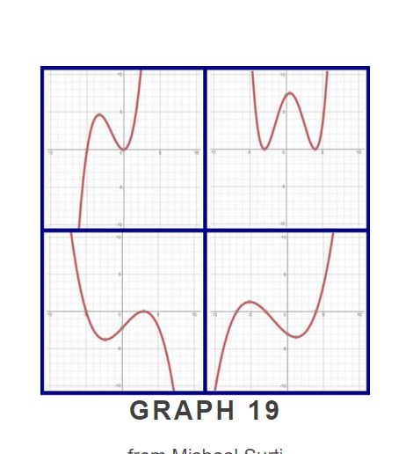
Which one doesn’t belong and why?

Slide 5
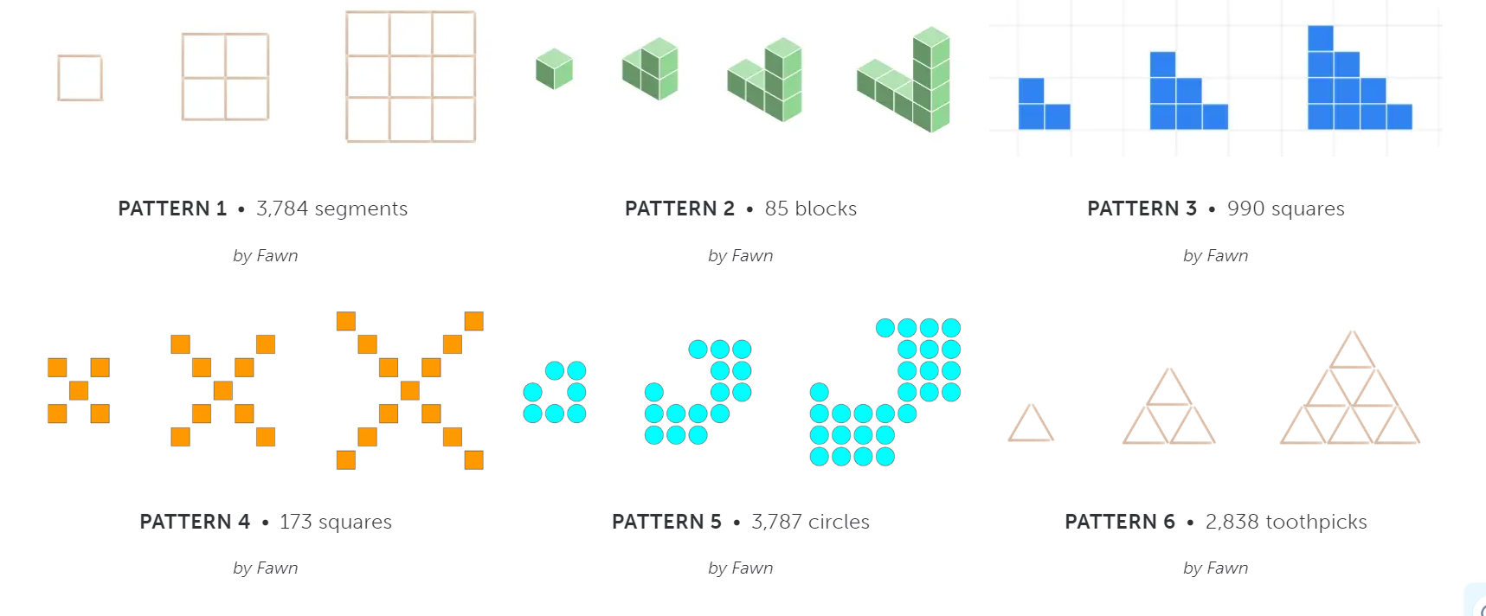

Slide 6
Strategy #1: Grab ‘em in the first 3 minutes
With something stimulating
With something that has an opportunity to discuss
With something that lends itself to more than one approach
With something that allows you to launch every lesson with some smiles and some thinking!

Slide 7
Subtext this morning:
The time to take action and improve our practice and our structures is now!
The time to make changes to make things much more mathematically better for our students and for our society is now!
(What gives me the right?
1500 schools and about 10,000 K-12 math classes)

Slide 8
Now that our brains are stimulated…
Some perspectives on why change is so imperative.
Or take this as my opening gifts to you.

Slide 9
1. We must remember that we are preparing them for a world of:
Complexity
Nuance
Ambiguity
(Our job is giving them tools to empower them to be effective leaders and difference makers in this world – spoon-feeding procedures that machines do better doesn’t accomplish this.)
Not thinking is learned behavior

Slide 10
2. In case you don’t think you are indispensable as we approach 2025:
Democracy
Debate
Evidence
Data
Data Analysis/Quantitative Literacy
Ergo there is a direct line from data analysis and quantitative literacy to the survival of our democracy

Slide 11
3. And most importantly:
Several months ago, while reading Street Data, I was called up short with the sentence: “Equity work is first and foremost pedagogical.” I’ve not read another word in the book and have been consumed by the implications of this sentence.
This morning we’ll look at some of these implications with practical examples

Slide 12
Ready?

Slide 13
Tell ‘em what you’re going to tell ‘em
.
#1: Grab ‘em in the first 3 minutes
#2: Put the math in context
#3: It’s instruction silly
#4: Actively engage every student in every class every day.
#5: Aligned assessments are key
ENABLED BY:
#6: Reduce tracking practices and use differentiation to reach all students
#7: Create high-quality high school pathways aligned with student
aspirations and higher education options.
#8: Create and use a shared, written common vision of excellence
#9: Ensure we have adequate time
#10: Foster a culture of professional collaboration

Slide 14
So let’s do some math (aligned with our lesson or unit goals)

Slide 15

What do you notice?
Omaha
244 miles
Omaha
Car Manual
Gas Tank Capacity:
21 gallons
Average MPG:
28.3

Slide 16
Compare that to this:

Slide 17
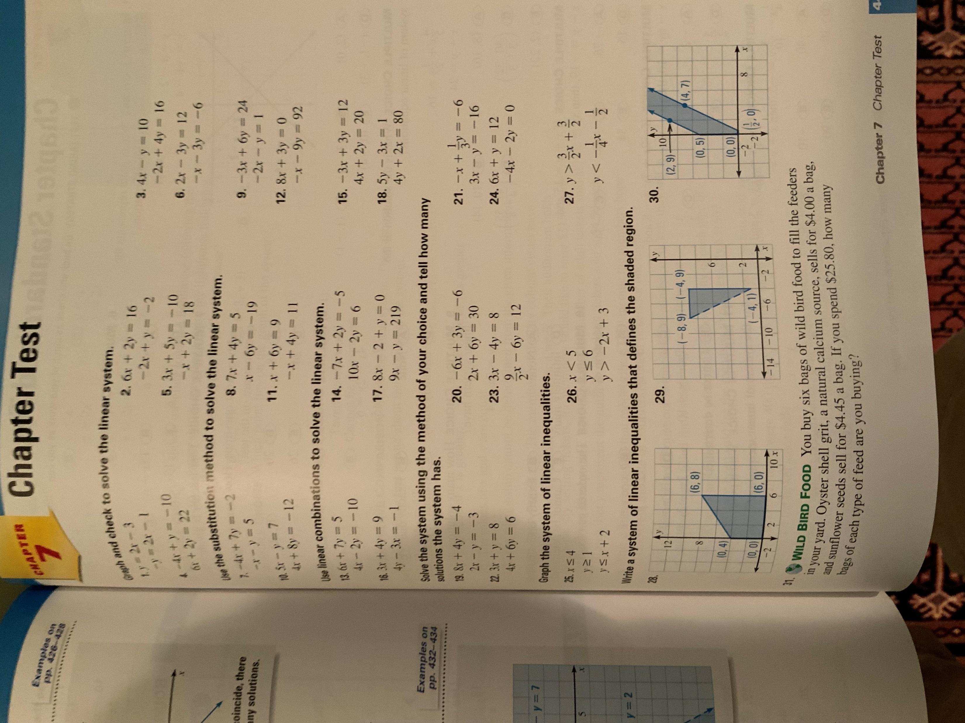
How does this humanize?
How does this invigorate?
How is this any different from the square root algorithm that no one misses?
For many it deadens.

Slide 18
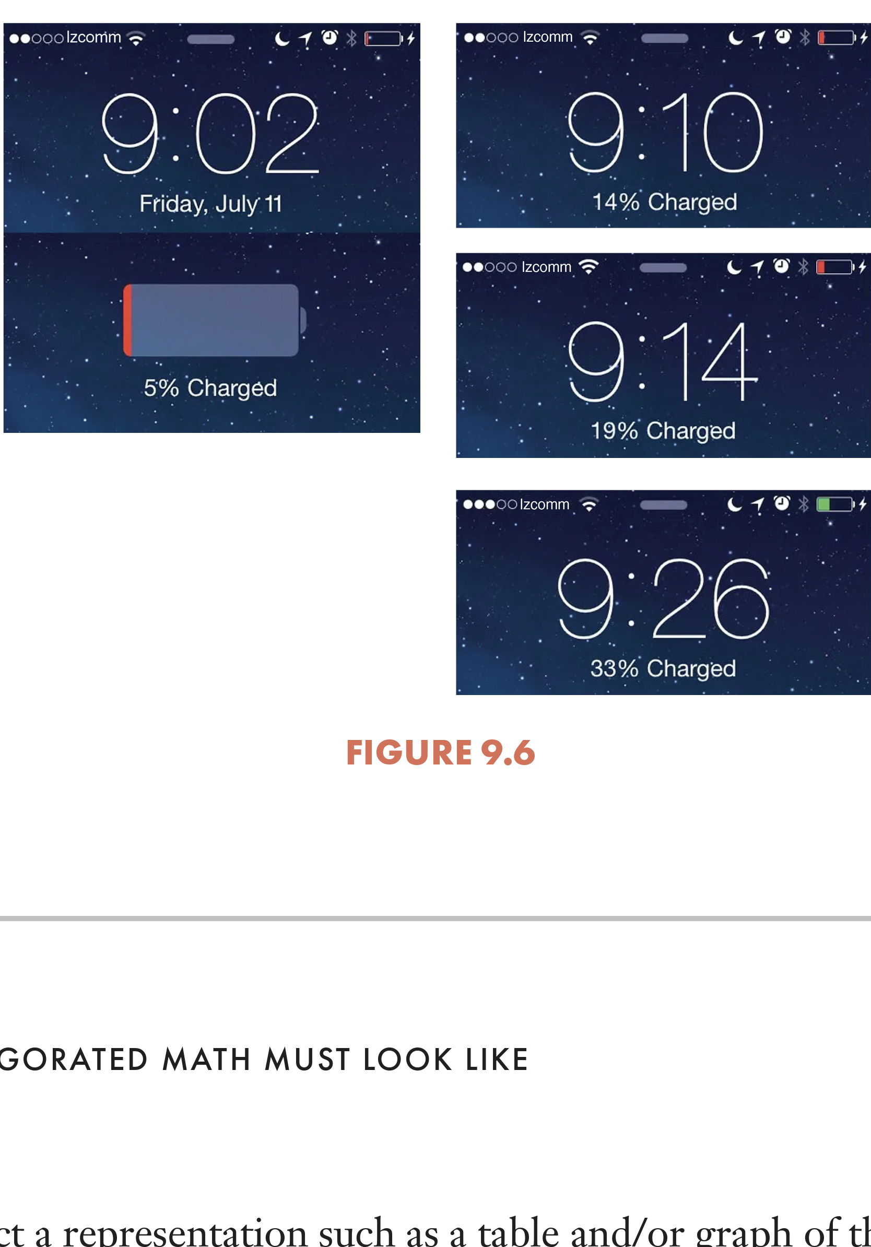
Alternatively:
It enlivens. It humanizes.
It invites interest. And it is fundamentally mathematical -
not as enrichment,
but as core instruction.

Slide 19
Strategy #2: Put the math in context (to launch and to consolidate)
Context minimizes “why are we learning this?”
Context is often familiar and engaging
Context supports application and modeling

Slide 20
Hello Grade 6! Our goal for today is to:
“Identify, create and understand equivalent expressions.”
Are you ready?

Slide 21
Number strings for today’s Mini Lesson
Are they equivalent? How do you know?
4(8) = 4(3 + 5)
4(8) = 4(a + 5)
4(8) = 4(3 + b)
3x + 3y = 3(x + y)
Let’s summarize: For each: Always, sometimes, never equivalent?

Slide 22
Math Workshop Task
Jan normally rides her bike to and from work.
Her normal route is 18 miles from home to work.
One day she goes to a coffee shop on her way to work and on her way home.
This adds x miles to her trip each way.
(“What do you notice?” “What’s the question?”)
Great: Write and show the distance Jan travels using a diagram or picture and two different, but equivalent, expressions.

Slide 23
Resulting in:
x 18
2
18 x
18 + x + 18 + x 18 x
2(18 + x)
2(x + 18)
x + x + 18 + 18
36 + 2x
“Is everyone correct? Turn and tell your partner why?”
“What do the numbers and variables represent?”
“Which expression is simplest or easiest to use? Why?”

Slide 24
Lesson 6 Exit Ticket
Which of the following represent equivalent expressions?
Explain or show your process of determining which expressions ARE equivalent.
Select all that apply:
a. x + x + x + x = 4x
b. 15 y + 5x = 3(5y + x)
c. 6(2 + x) = 12 + 6
d. 3(x + y) = 3x + y

Slide 25
Strategy #3: It’s instruction silly
They learn far more from our QUESTIONS than our talking and showing.
Equity is first and foremost pedagogy
We know what makes a real difference in learning
Planning and animated slides are powerful levers of quality

Slide 26
Principles to Actions: Ensuring Mathematical Success for All
Mathematics Teaching Practices
Establish mathematics goals to focus learning.
Implement tasks that promote reasoning and problem solving.
Use and connect mathematical representations.
Facilitate meaningful mathematical discourse.
Pose purposeful questions.
Build procedural fluency from conceptual understanding.
Support productive struggle in learning mathematics.
Elicit and use evidence of student thinking.

Slide 27
Elements of Quality or What we Know
Clarity of goals (not Lesson 4.5 or pages 214-217)
Context (not naked)
Rich tasks (not exercises)
Focused intentional questions (not punting)
Opportunities for discourse (not just telling)
Gradual reveal (not just a dumping)
Multiple representations (not one way)
Alternative approaches (not one way)
Explanations and justifications (not just answers)
Common errors and misconceptions (not just right correct approaches)
Sense-making by students (not lecture)
Evidence (not I taught it and let the chips….)

Slide 28
Nine Generic Questions
1. Why is that? (Who can give a different reason?)
2. Can you explain your thinking? (Who can explain it differently?)
3. Can you convince the class? (Who can convince us in a different way?)
4. How did your brain picture that? (Who pictured it differently?)
5. How do you know that? (Is there another way?)
6. How are they similar?
7. How are they different?
8. What do you notice?
9. What do you wonder?

Slide 29
What we know:
When teaching is driven by rules that make no sense:
- Keep, change, change (KCC)
- Keep, change, flip (KCF with IEP students)
- The butterfly method (OY)
student understanding is being undermined. And frankly we are complicit when we look the other way.

Slide 30
Strategy #4: Actively engage every student in every class every day
And when we do these practices, we are actively engaging our students and their brains every day.

Slide 31
In too many classrooms, math students quietly practice dozens of problems that test the latest skill, or worse—passively watch a teacher practice that same skill. The result? A few students grow to see themselves as “smart” because their prior opportunities allow them to follow the teacher, and they quickly and accurately get the right answer. Far too many see themselves as “not math people” because they take too long, make a silly mistake, or miss some key ideas. Practice is essential, but receiving feedback on three or four exercises before moving on and employing distributed practice over time is far more productive. Moreover, spending precious minutes on practice overkill fails to engage most students.

Slide 32
Lessons need to balance a passive showing, telling, and practicing approach with a more active, collaborative, and engaging approach that uses concrete materials, whiteboards to publicly display thinking, and high-quality digital tools to play with and discuss mathematical ideas. By doing this, we bring compelling research findings, as well as common sense, into our mathematics classrooms.

Slide 33
Ergo:
Don’t let anyone tell you we don’t know what to do
Don’t let anyone tell you that it can’t be done in every school
Don’t let anyone blame the kids and their families or their color or their income
Don’t let anyone tell you it takes billions more dollars
Because I’ve been in schools that show it can be done

Slide 34
And in case you are not convinced…

Slide 35
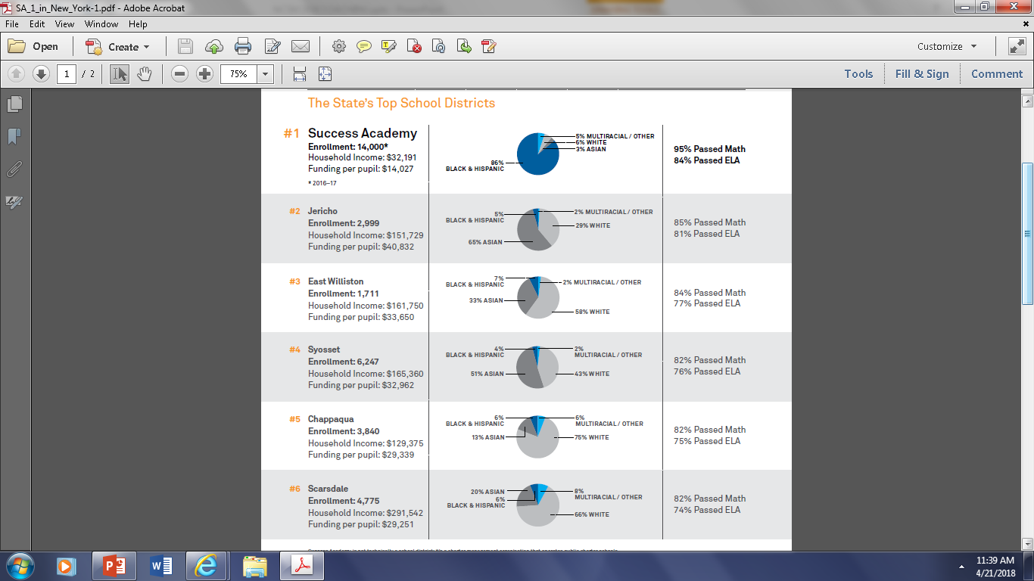
Success Academy

Slide 36
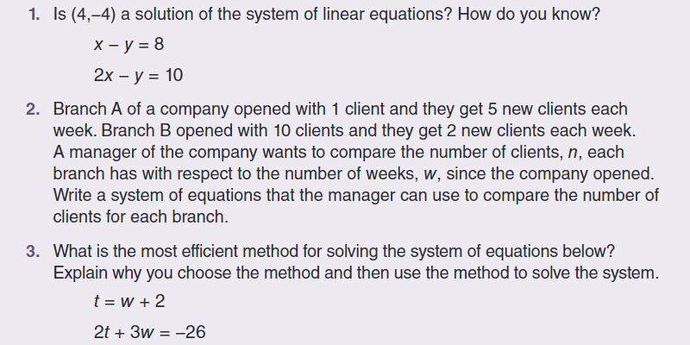
Systems of Linear Equations Unit Assessment

Slide 37
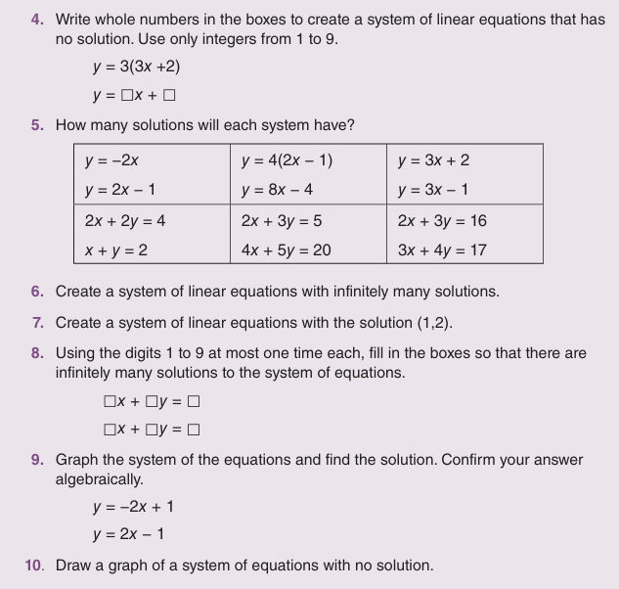

Slide 38
What, How and HOW WELL?
Assessments are essential components of an educational system. They provide evidence of learning, challenges, successes, and failures. When this evidence is used, individually and collectively, to reteach or revise teaching, assessments can significantly strengthen teaching and learning. However, teachers are torn between the typically multiple-choice and overwhelmingly skill-focused state assessments, benchmark assessments, SATs, ACTs, and APs over which they have no control on the one hand, and the asset-based, open-ended, show-your-work, justify your thinking test items of a truly balanced curriculum on the other.

Slide 39
Strategy #5: Aligned Assessments are Key
High performing schools recognize that imposed and required assessments are part of the landscape, but their laser-like focus is on daily formative assessments that provide evidence of the effectiveness of every lesson and high-quality, aligned, unit or chapter assessments toward which teachers are expected to teach from grades 2 to 12. These are the parts of a sensible system of assessment over which teachers have control, can easily revise, and for which they should be held accountable.

Slide 40
What we know
Formative assessments – administered and used – have the highest effect size of any other practice.
When there are no retesting policies, we are just being lazy and mean and hurting kids…
It’s about time we started teaching to high-quality ALIGNED assessments.

Slide 41
What enables this work?

Slide 42
#6. Reduce tracking practices, using differentiation to reach all students.
The tracking and leveling of students, as practiced in many schools, limits the opportunity for some and undermine our efforts to promote equity and empowerment of all students. For example, when some students get accelerated into 8th grade Algebra 1 to prepare them for Calculus in 12th grade, expectations for those not accelerated are often lowered, and opportunities are reduced. These students are told they just are not good enough in math, and they live up to these low expectations.

Slide 43
Differentiation strategies can replace some tracking practices, more equitably reaching more students. Teachers recognize that in any class of about 24 students, there are almost always multiple ways that these students are processing the mathematics, and an equal number of ways these students are picturing or visualizing the math. Of course, there are students who, for example, immediately know that 8 + 9 is 17, but others have mastered this fact by thinking 8 + 10 is 18 minus 1 is 17, or by thinking 8 + 8 is 16 plus 1 is 17, or even 10 plus 10 is 20 minus 3 is 17. Similarly, when finding 5 + (-9), some students visualize gaining and losing money, others think of gains and losses on a football field, and still others visualize a thermometer and do signed number arithmetic on a vertical number line. Encouraging and validating such alternative strategies and approaches and pushing all students to both understand and make connections among a variety of representations and to eventually think abstractly, will lead to significant gains for everyone.

Slide 44
#7: Create high-quality high school pathways (aligned with student aspirations and higher education options).
When students leave elementary school, they all move on to middle school, and it makes sense that there is a common elementary curriculum. Similarly, when students leave middle school, they all move on to high school, again arguing for a common middle school curriculum. However, when high school must prepare students for a variety of futures—immediate employment, the military, non-STEM coursework at community colleges, non-STEM coursework at four-year colleges and universities, STEM coursework at 2-year and 4-year institutions of higher education, and STEM coursework at selective four-year colleges and universities—a single high school pathway cannot meet these diverse aspirational routes.

Slide 45
Colleges and universities have broadened course offerings beyond a single calculus pathway, and high schools must expect four years of mathematics organized around a common, integrated program of two or three years of algebra, geometry, and statistics. This is followed by equally rigorous, but differentiated calculus, statistics, data science, and quantitative literacy options in the last year or two of high school. Importantly, students should choose an option based on their own aspirations (not others’ perceptions of their ability), and all options should lead smoothly into four-year degree programs.

Slide 46
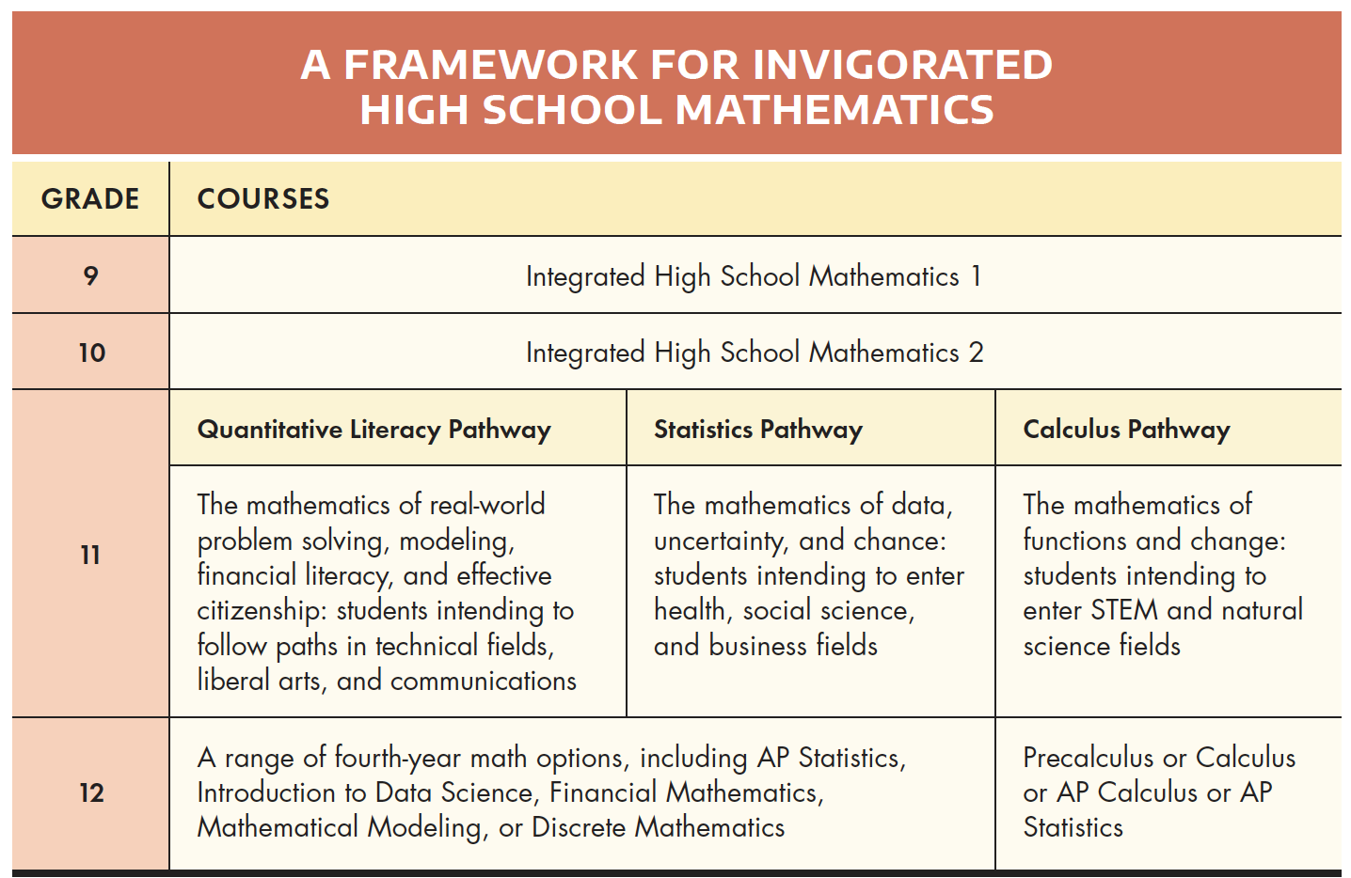
How we might organize High School Math

Slide 47
Strategy #8: Create and use a shared, written common Vision of Excellence
As a nation, we need clarity about what effective teaching and learning of mathematics looks like, providing explicit, research-affirmed guidance to all who teach mathematics and narrowing the range of instructional quality. This goal is met in many schools and districts with a shared vision of effective teaching and learning of mathematics that informs instructional decisions, professional development, supervision, evaluation, and hiring. Such an effective vision statement describes what one would see in a classroom where mathematics instruction was impactful, including such elements as the clarity of learning goals, use of rich tasks, drawing on familiar contexts, student engagement and discourse, effective differentiation by means of alternative approaches and multiple representations, and the gathering and use of formative evidence of success.

Slide 48
A sample vision statement
Our shared commitment is that every Highlands School student receives well-planned, well-executed mathematics instruction that consistently reflects our vision of active engagement in thought-provoking tasks, productive discussion about mathematical ideas and common misconceptions, and the individual and collective construction of understanding via problem-solving and inquiry.

Slide 49
This commitment requires that teachers plan their lessons around rich tasks that are supported by targeted questions and powerful lesson debrief discussions. Such lessons are diametrically opposite of the “I show, we practice, you do” model of direct instruction that essentially tells students what to remember and how to get right answers. For example, the “trick” to “invert and multiply” (as opposed to understanding that dividing by a number is the same of multiplying by the inverse of that number) works in the short-term, but does not support mathematics as a sense-making enterprise and does not foster an inherent love of mathematics and its power and beauty.

Slide 50
What students ARE doing: | What teachers ARE doing: | What leaders ARE doing:
Actively engaging in solving rich problems that are aligned with the curriculum standards Regularly engaging in productive discourse about their thinking and reasoning Grappling with mathematical ideas and making and exploring conjectures about those mathematical ideas | Thoroughly studying the curriculum standards, the textbook and other resources to develop an understanding of the key mathematical understandings across a grade, unit, or lesson Carefully selecting rich tasks that support reasoning and problem solving Anticipating students’ solutions and strategies to each task Carefully crafting and asking targeted questions that focus on the key mathematical understandings Making frequent use of the “discourse clouds”: Why? Can you explain? Who did it differently? Convince us? How did you picture that? Regularly collecting and using formal and informal evidence to assess scholar understanding of the big mathematical ideas and adjusting their instruction accordingly | Regularly meeting with teachers to help them think through their lesson plans, including clarifying the learning goal, the selection of rich, aligned tasks and the questions to be asked during the lesson Co-teaching the lesson in ways that support the teacher and maintain a focus on the learning goals Taking notes to support a productive debriefing and action planning session

Slide 51
What students are NOT doing: | What teachers are NOT doing: | What leaders are NOT doing:
Solving more than three naked problems from a worksheet without the chance to explain their thinking Listening to explanations by the teacher without interruption Regurgitating procedures to get answers | Showing students how to solve problems and expecting them to replicate the process solely on the basis of remembering Using the phrases “this is the rule” or this is “how you solve this” or “this is what you have to remember” without including reasons, explanations or a focus on WHY Allowing students to solve problems without providing any opportunities for feedback | Sitting on the sidelines, not interrupting or participating in the lesson Using the co-teaching/coaching process only for evaluation Only using co-teaching and coaching, with no opportunities for pre-planning or debriefing

Slide 52
Strategy #9: Ensure we have adequate time
When math class periods are only 45 or 47 or 49 minutes, teachers are being set up.
Effective teaching of our standards requires 60 minutes per day!

Slide 53
We are adamant that 58 minutes/day for math is the absolute minimum EVER.
Watch me: kids in rows 47 minute period
I rush. I get shrill. I watch the clock. I cut corners. I fail to be responsive to students.
Then watch me: kids in groups of 3 or 4 60 minutes
All the difference in the world – time for cumulative review or number talk, time for an exit ticket, time to think, time to use lesson chunks.

Slide 54
Effective, equity-minded teachers:
When asked:
“Why aren’t our math scores higher?”
“Why are do many students more being more successful?”
Non-compliant leaders respond:
“Simple. Our kids and teachers are cheated by anything less than 60 minutes given the district/state curriculum.”
And then we compromise at 58.

Slide 55
Both the quality and quantity of time are critical components of high-quality mathematics programs. Too often, curriculum materials that are written on the basis of up to 60 minutes per day are squeezed into 40- or 50-minute periods that seriously compromise teachers’ abilities to effectively implement the programs.
Limited time results in limited quality regardless of the overall quality of the use of that time. Similarly, adding more time without using it to implement many of these actions is unlikely to make much of a difference in student learning. No one argues that mathematics warrants an equivalent allocation of time as English Language Arts (ELA), but when the gap between ELA and mathematics is often more than an hour each day, changes to school schedules must be considered.

Slide 56
Finally, as we all know:
When it comes to most PD,
What is typical is done TO us, rarely WITH us.
What is typical ignores common sense and research.
What is typical hasn’t worked and needs to change.
In fact, in two major random controlled studies, even incredibly well planned and delivered PD resulted in:
No change in teacher knowledge;
No change in teacher classroom practice; and
Therefore, no change in student achievement.
Ergo: it is not “professional” and it doesn’t “develop.”
And we all know it.

Slide 57
Strategy #10: Foster a culture of professional collaboration
Every teacher, whether a novice or a veteran, will tell you that professional isolation drains their souls and spirit and compromises their effectiveness. These same teachers recount the joy and impact of their professional learning communities, their grade-level or course teams, their collaborative planning, and collegial observations. In every mathematically effective and high-performing school, there are supported structures like these, expectations for collaboration and allocated time to co-planning, co-observing, and co-reflecting. Wander through a school with members of the business community and the first thing they ask is how and why educators accept such a wide range of quality from classroom to classroom. “Teachers are allowed to stay isolated and disconnected” is a valid, but very unsatisfactory, answer. In contrast, when teachers have the time, space, and support to collaboratively plan, exchange visits, and brainstorm solutions together, they report both higher satisfaction and greater student gains.

Slide 58
We need to demand a focus on real Professional Development
Common sense, research-affirmed PD practices that :
help us envision the shifts
address beliefs and mindsets
link opportunities for practice and feedback
involve collaborative work
As opposed to after-school, one-shot, fragmented, not relevant to real needs, imposed PD that rarely focuses on teaching and learning.

Slide 59
Effective, collegial visits with respectful debriefs
The answers to nearly all of our challenges reside to one degree or another within our schools.
No one knows all and no one is perfect – we’re teachers – but someone knows and does things that we don’t.
Why do we act as though there were dragon-infested moats around our classooms?
The best schools I know have a system of at least one collegial classroom visit every other week.
Prep periods, test periods with coverage, substitute enabled, during specials – don’t tell me you go non-stop from 8 to 3 M-F.
Followed up ASAP with a truly collegial and professional discussion…

Slide 60
I have visited your math class earlier today.
What really impressed me (and why)…was…
The questions I have about what you/I did are… (let’s talk and consider these things you might want to consider)
The two things that I will consider doing differently starting tomorrow are… (BOTH the observer and the one being observed)

Slide 61
Effective teachers subversively expand the use of video, they use videotape
Have you ever videotaped yourself teaching?
Have you critically reviewed the video by yourself?
Have you done it with others?
Have you considered the power of building a video library of powerful teaching?
Have you considered the difference between an observation and capturing the observation on start-pause-go back video?

Slide 62
In summary:

Slide 63
Here’s what successful schools understand
It’s the quality of teaching that matters most – every lesson, every day
Kids forget and this expected forgetting must be intentionally addressed
Kid’s learn, visualize and process math differently so that deliberate, planned differentiation is non-negotiable
Our questions and their discourse are far more impactful than our telling and showing
Context matters and drill and kill KILLS
Every lesson must include aligned formative assessment that is then used to reteach and/or target instruction
Teachers cannot do it alone or without quality support

Slide 64
Revealing my Age
As Bobby Kennedy said:
“Some people see things as they are and ask why; I dream things that never were and ask why not?”
I ask you: Why not?
Thank you!

