Slide 1
Practical Ideas for Responding to the Challenges of Teaching Middle School Math
NH ASCD
March 22, 2024
Steve Leinwand
American Institutes for Research
sleinwand@air.org www.steveleinwand.com

Slide 2
Let’s see what it might look like and parse out what we observed.
Then let’s move from 6-8 in general, to the curriculum, to assessment and back to instruction.

Slide 3
Tell me what you notice.
A recipe calls from 2 cups of water for every 5 cups of flour.
How much flour for each cup of water?
Explain your reasoning.
Who did it differently?
How much water for each cup of flour?
Explain your reasoning.
Who did it differently?
Suppose I only have 8 cups of flour?
Answers AND Justifications.

Slide 4
Tell me what you see.
.
Vocabulary is key

Slide 5
Care to join me in a 6th grade class?

Slide 6
Grade 6 SA Harlem Central Tues Dec 8, 2015
Lesson 6 in the Expressions unit (6.EE standards)
Ally and Mabubar co-teaching
19 Scholars
Driven by a number strings mini-lesson, a Math Workshop task and an exit ticket
“Our goal for today is to “identify, create and understand equivalent expressions.”
“Zayasia, can you please repeat our learning goal?”
“Let’s begin with out number strings.”

Slide 7
Number strings for today’s Mini Lesson
Are they equivalent? How do you know?
4(8) = 4(3 + 5)
4(8) = 4(a + 5)
4(8) = 4(3 + b)
3x + 3y = 3(x + y)
Let’s summarize: For each: Always, sometimes, never equivalent?

Slide 8
Math Workshop Task
Jan normally rides her bike to and from work.
Her normal route is 18 miles from home to work.
One day she goes to a coffee shop on her way to work and on her way home.
This adds x miles to her trip each way.
Great: Write and show the distance Jan travels using a diagram or picture and two different, but equivalent, expressions.

Slide 9
Resulting in:
18 x
2
x 18
18 + x + 18 + x 18 x
2(18 + x)
2(x + 18)
x + x + 18 + 18
36 + 2x
“Is everyone correct? Turn and tell your partner why?”
“What do the numbers and variables represent?”
“Which expression is simplest or easiest to use? Why?”

Slide 10
Lesson 6 Exit Ticket
Which of the following represent equivalent expressions?
Explain or show your process of determining which expressions ARE equivalent.
Select all that apply:
a. x + x + x + x = 4x
b. 15 y + 5x = 3(5y + x)
c. 6(2 + x) = 12 + 6
d. 3(x + y) = 3x + y

Slide 11
Your turn: One by one, where did each of these live in this lesson?
Establish mathematics goals to focus learning.
Implement tasks that promote reasoning and problem solving.
Use and connect mathematical representations.
Facilitate meaningful mathematical discourse.
Pose purposeful questions.
Build procedural fluency from conceptual understanding.
Support productive struggle in learning mathematics.
Elicit and use evidence of student thinking.
NCTM Principles to Actions:
The 8 Mathematics Teaching Practices

Slide 12
Turn and Talk: What made this lesson effective?

Slide 13
Elements of Quality
Clarity of goals (not Lesson 4.5 or pages 214-217)
Context (not naked)
Rich tasks (not exercises)
Focused intentional questions (not punting)
Opportunities for discourse (not just telling)
Gradual release (not just a dumping)
Multiple representations (not one way)
Alternative approaches (not one way)
Explanations and justifications (not just answers)
Common errors and misconceptions (not just right correct approaches)
Sense-making by students (not lecture)
Evidence (not I taught it and let the chips….)

Slide 14
And now we’re off to Grade 8.
You choose:

Slide 15
How does this humanize?
How does this invigorate?
How is this any different from the square root algorithm that no one misses?
For many it deadens.

Slide 16
Alternatively:
It enlivens. It humanizes.
It invites interest. And it is fundamentally mathematical -
not as enrichment,
but as core instruction.

Slide 17
So Middle School:
The critical middle – when it works vs. when it doesn’t work
The particularly essential role of grade 6
Engagement
Discourse
Our questions
Tasks of value and interest
Fun!!!!

Slide 18
With the Common Core, and its similar cousins, all of a sudden, to enable significant and appropriate algebra, geometry and statistics in grades 7 and 8, grade 6 has taken on critical importance as perhaps the most challenging and most impactful grade to teach in the entire preK12 curriculum. This is not because of too much content, in fact, there is enough time to do 6th grade right with 60 minutes per day, but because of the newness and complexity of so many of the grade 6 standards. Let me try to be more specific about both the context and the content.
www.steveleinwand.com/publications

Slide 19
Grade 6
8 weeks on the culmination of arithmetic – fractions, decimals, problems, contexts, which operation and why, estimation
8 weeks on ratio and rate – multiplicative changes and applications
8 weeks on variables, expressions and equations and contexts
AND IF TIME: 4 weeks Stat and 4 weeks Geometry

Slide 20
Grade 7
8 weeks on ratio, rate, proportion, percent
4 weeks on integers and rational numbers
8 weeks on algebra – variables, expressions and equations, linking the symbols to contexts
6 weeks on probability (review of fractions)
6 weeks on geometry

Slide 21
Grade 8
12 weeks- Integers, linear equations, linear functions, systems of equations
6 weeks - Congruence and transformations
6 weeks Exponents, roots and Pythagoras
4 weeks - Volume/surface area – applications
4 weeks - Data representations and interpretation
4 weeks - Exponential change

Slide 22
Assessment
We’ve got to focus on:
Daily formative assessment (exit tickets) that answer the question “To what degree did my students learn what they needed to learn today?”
Common, high quality, balanced unit assessments toward which we teach!!!

Slide 23
But it’s instruction silly!

Slide 24
One big thing to think about:
Shifting SOME of who is doing the work and what maximizes learning?
Showing?
Telling?
Practicing?
OR
Student engagement driven by our tasks
Student discourse driven by our questions
Whiteboards
Pairs
Feedback

Slide 25
Lesson Chunking
To promote engagement and maintain interest
¼ individual
½ group
¼ whole class – often early and late!

Slide 26
Discourse – Student Talk
What we know:
teachers talk far more that students, often to the detriment of learning;
discourse is a visible sign of engagement and engagement is a prerequisite for learning.
What needs to be considered:

Slide 27
For example:
Solve for x: 3x + 18 = 48
What is the value of x?
AND THEN:
How did you get it?
Who did it differently?
How do you know 10 is correct?
ERGO: Less is more!

Slide 28
Nex

Slide 29
Classroom Discourse
Why?
How do you know?
Can you explain that? (and who did it differently?)
Convince us.
How did you picture that? (and who did it differently?)
What do you notice?
What do you wonder?
How are they the same?
How are they different?

Slide 30
Differentiation
Alternative approaches
Multiple representations
Elicited via our questions

Slide 31
For every function:
Words
Table
Graph
Equation

Slide 32
For every function:
Words – communicating
Table - organizing
Graph - visualizing
Equation - generalizing

Slide 33
Remember How
5 + (-9)
“To find the difference of two integers, subtract the absolute value of the two integers and then assign the sign of the integer with the greatest absolute value”

Slide 34
Understand Why
5 + (-9)
Have $5, lost $9
Gained 5 yards, lost 9
5 degrees above zero, gets 9 degrees colder
Decompose 5 + (-5 + -4)
Zero pairs: x x x x x O O O O O O O O O
- On number line, start at 5 and move 9 to the left

Slide 35
Solving Simple Linear Equations
3x + 7 = 22

Slide 36
3x + 7 = 22
How do we solve equations:
Subtract 7 3 x + 7 = 22
- 7 - 7
3 x = 15
Divide by 3 3 3
Voila: x = 5

Slide 37
3x + 7
Tell me what you see.
Suppose x = 0, 1, 2, 3…..
Let’s record that:
x 3x + 7
0 7
1 10
2 13
4. How do we get 22?

Slide 38
3x + 7 = 22
Where did we start? What did we do?
x 5
x 3 3x 15 ÷ 3
+ 7 3x + 7 22 - 7

Slide 39
3x + 7 = 22
X X X IIIIIII IIII IIII IIII IIII II
X X X IIIII IIIII IIIII

Slide 40
Domain of Change: Alternative Approaches and Multiple Representations (ergo: Differentiation)
Siti packs her clothes into a suitcase and it weighs 29 kg.
Rahim packs his clothes into an identical suitcase and it weighs 11 kg.
Siti’s clothes are three times as heavy as Rahims.
What is the mass of Rahim’s clothes?
What is the mass of the suitcase?

Slide 41
The old (only) way:
Let S = the weight of Siti’s clothes
Let R = the weight of Rahim’s clothes
Let X = the weight of the suitcase
S = 3R S + X = 29 R + X = 11
so by substitution: 3R + X = 29
and by subtraction: 2R = 18
so R = 9 and X = 2

Slide 42
Or using a model:
11 kg
Rahim
Siti
29 kg

Slide 43
Or using a model:
11 kg
Rahim | x | y
Siti | x | x |  | x
29 kg

Slide 44
Rich Tasks
Embed the math in contexts
Give students a reason to care

Slide 45
What’s the question? What’s the answer?
Omaha
244 miles
Omaha
Car Manual
Gas Tank Capacity:
21 gallons
Average MPG:
28.3

Slide 46
Why did you care?
Will you make it?
About how far will you get?
How much gas needs to be in the tank to be sure you make it?

Slide 47
So:
Answer getting
Vs.
Explanations, alternatives, connections

Slide 49
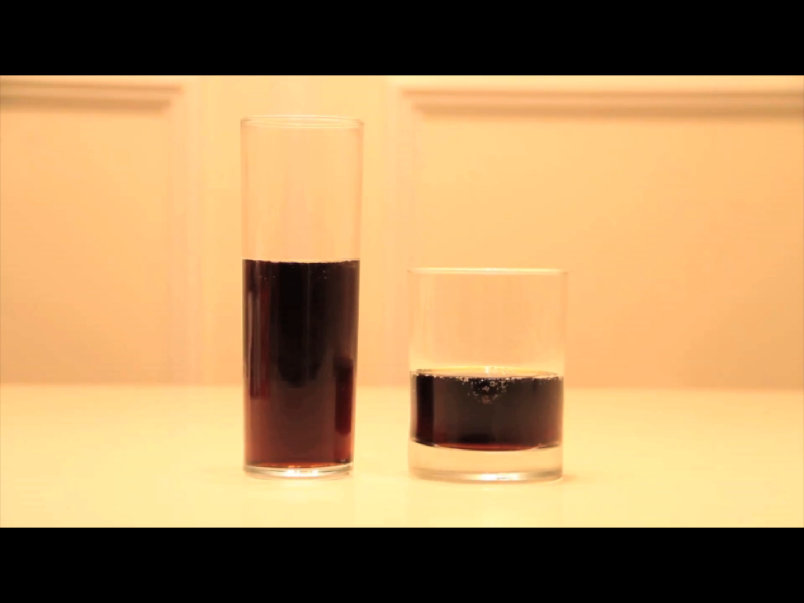
Tell your partner three things you see here.
Notes:
Goal:
The goal of this slide is to ask students to apply their intuition, make a guess and justify their guess. Because they’ve guessed, students may now be curious to know which of them guessed correctly. and guess an answer. After this slide, students may want to know which of them guessed correctly.
Teaching Moves:
Ask students to write down guesses. Say, “Would you please write down on your handout which you think has more: the left or the right? Or do they have exactly the same?” [Why?]
Ask students to pair and share. Say, “Share your guess with your neighbor. Do you both agree? Do you disagree?”
Take a classwide poll of guesses. Ask for a show of hands. “Who thinks the left one has more? The right? The same?” Write down approximate counts of the guesses on the board. [Why?]
Interesting Outcomes:
The class is divided. The video IS intendED to create controversy. The ideal outcome has the class split into two or three groups of different opinions. At that point, the more you can play up the controversy (“Oooo ... big fight. We can’t all be right, people!”) the more interested students will be in the answer. [Why?]

Slide 50
What is your guess? Share your guess with your neighbor and justify your guess.
Notes:
Goal:
The goal of this slide is to ask students to apply their intuition, make a guess and justify their guess. Because they’ve guessed, students may now be curious to know which of them guessed correctly. and guess an answer. After this slide, students may want to know which of them guessed correctly.
Teaching Moves:
Ask students to write down guesses. Say, “Would you please write down on your handout which you think has more: the left or the right? Or do they have exactly the same?” [Why?]
Ask students to pair and share. Say, “Share your guess with your neighbor. Do you both agree? Do you disagree?”
Take a classwide poll of guesses. Ask for a show of hands. “Who thinks the left one has more? The right? The same?” Write down approximate counts of the guesses on the board. [Why?]
Interesting Outcomes:
The class is divided. The video IS intendED to create controversy. The ideal outcome has the class split into two or three groups of different opinions. At that point, the more you can play up the controversy (“Oooo ... big fight. We can’t all be right, people!”) the more interested students will be in the answer. [Why?]

Slide 51
What information is important here?
How would you get it?
Notes:
Goal:
The goal of this slide is for students to see that diameter and height are the essential variables for finding volume and also the easiest to measure with a ruler.
Teaching Moves:
Ask students what information is important. Ask, “What information would be useful to know here and how would you get it? Would you write down some ideas for yourself on your handout?” [Why?]
Ask students to pair and share. Say, “Share your ideas with your neighbor. Do you both agree? Do you disagree about what’s necessary?”
Make a list of information requested. Ask students to share the information they want. Write suggestions on the board next to the owner’s name or type them in a document, depending on which is faster for you. But record everything. The goal here isn’t to pass judgment on good and bad suggestions. It’s to collect student ideas. There’s no need to collect every student’s idea, though. Once you’ve recorded a broad cross-section of the class’ ideas, cut the process short. [Why?]
Push students for precision. See the interesting outcomes below and how you might respond. As you pull and tug on certain students’ responses, put a star or some marking next to the suggestion to illustrate that you’ve addressed it. It isn’t necessary to address all of them. This is a chance to redirect students to more precise mathematical vocabulary. For example, some teachers would start a lesson by introducing the vocabulary. However we didn't, so when students say, "We need to know how tall and wide the glasses are" teachers can say something, "When we are talking about cylinders, we call how tall they are their height and how wide they are their diameter
Interesting Outcomes:
Students ask for a measuring cup so they can find volume. Take this one first. Say something like, “Great idea. That’d be so easy and we could all get out of here for break. But unfortunately I don’t have a measuring cup and all I’m working with at the moment is a ruler.”
Students ask for “height.” This isn’t very precise so we’ll push on it. Say, “Okay, when you ask for height? You’re looking for this height here, right?” Then put your fingers from the very top of the glass to the very bottom of the glass. They need to tell you, “No, we want the height of the soda.”
Students ask for “radius” or “diameter” or “circumference.” Talk about how we know we can turn any one of those facts into any of the others. But which of those three is easiest to get and which is hardest? Have them think about the question for a minute and write down a response, then share it with a neighbor.
Radius. Radius is difficult because it relies on finding the center of the glass, which is invisible.
Circumference. Circumference is difficult with a ruler, of course. But even if you allow a piece of string (or a seamstress’ tape) it doesn’t help to pull the string taut around the outside of the glass because that will include the thickness of the glass in with the soda. It’s difficult to pull the string taut around the inside of the glass, which is what’s required.
Diameter. Diameter may seem easiest but it too relies on finding the center of the circle. We know a curious fact about circles that may be very helpful, though: The diameter is the longest chord in a circle. So fix one end of the ruler to a point on the circumference of the glass and then rotate the ruler around the rest of the glass. The longest measurement has to be the diameter.
Students ask for some extremely precise information. For example, “Is it really a cylinder?” or “What about the thickness of the glass?” or “Is the bottom of the glass really flat?” It may seem initially that these students are being disruptive or disagreeable but every other student ought to emulate this attention to precision. Answer these questions directly and with sincerity, “It’s really a cylinder.” and “We’ll get measurements that take the thickness of the glass into consideration.” and “The bottom of the glass is really flat.” Then throw a lot of praise on them.’’

Slide 52
5.5 cm
7 cm
10 cm
3 cm
Notes:
Goal:
The goal of this slide is to give students the information you’ve settled on as most precise and easiest to measure with the tools on hand, all without implying a specific solution strategy yet. The goal of this slide is that students struggle productively, and come to so that they crave more information so they can know what to do with this information and worry abouat what to do with this information, all before you teach them the formula for volume.
Teaching Moves:
Give them some time to struggle. Say, “Okay, you guys asked for this information because you had some rough, fuzzy plan for it. I want you to take a minute to work on your own and put that plan into action.” [Why?]
Ask them to share ideas with their neighbors. Don’t expect your students to just “discover” the formula for cylinder volume. Don’t expect all this understanding to arise without some intervention on your part. But if students invest time and struggle in the question, they’ll want the explanation even more and be in a better place to appreciate it.
Interesting Outcomes:
They don’t solve the problem. In this case we’ll move to the lecture in the next slide.
Some students solve the problem. This is always a possibility. If a student solves the task quickly, pose one of the extension questions we’ve included in later slides.

Slide 54
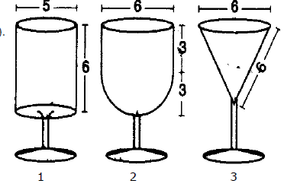
Your turn:

Slide 55
So?
Order from smallest to largest and justify
What is the height of Glass 3?
What is the volume of each?
If Glass 1 has volume V, express volume of Glasses 2 and 3 in terms of V
When Glass 1 is ½ full, the height of the liquid is 3 cm. What are the heights of the liquid in Glasses 2 and 3 when they are ½ full?

Slide 56
You choose:
Given: F = 4 (S – 65) + 10
Find F when S = 81.
Vs.
The speeding fine in Vermont is $4 for every mile per hour over the 65 mph limit plus $10 handling fee.

Slide 57
Connecticut: F = 10 ( S – 55) + 40
Maximum speeding fine: $350
Describe the fine in words
At what speed does it no longer matter?
At 80 mph how much better off would you be in VT than in CT?
Use a graph to show this difference

Slide 58
Putting it all together one way
Good morning class.
Today’s objective: Find the surface area of right circular cylinders.
Open to page 384-5.
3
Example 1:
4 S.A.= 2πrh + 2 πr²
Find the surface area.
Homework: Page 385 1-19 odd

Slide 59
Putting it all together another way
Overheard in the ER as the sirens blare:
“Oh my, look at this next one. He’s completely burned from head to toe.”
“Not a problem, just order up 1000 square inches of skin from the graft bank.”
You have two possible responses:
Oh good – that will be enough.
OR
Oh god – we’re in trouble.

Slide 60
Which response, “oh good” or “oh my” is more appropriate?
Explain your thinking.
Assuming you are the patient, how much skin would you hope they ordered up?
Show how you arrived at your answer and be prepared to defend it to the class.

Slide 61
Exit slip: Sketch an object and it’s dimensions that has a surface area of about 100 square inches?
Homework: How many square cm of skin do you have and be prepared to show how you arrived at your answer.

Slide 62
Why do you think I used these tasks?
Standards don’t teach, teachers teach
It’s the translation of the words into tasks and instruction and assessments that really matter
Processes are as important as content
We need to give kids (and ourselves) a reason to care
Difficult, unlikely, to do alone!!!

Slide 63
Professional Collaboration
We really can’t do this by ourselves

Slide 64
To collaborate, we need time and structures
Structured and focused department meetings
Before school breakfast sessions
Common planning time – by grade and by department
Pizza and beer/wine after school sessions
Released time 1 p.m. to 4 p.m. sessions
Hiring substitutes to release teachers for classroom visits
Coach or principal teaching one or more classes to free up teacher to visit colleagues
After school sessions with teacher who visited, teacher who was visited and the principal and/or coach to debrief
Summer workshops
Department seminars

Slide 65
To collaborate, we need strategies 1
Potential Strategies for developing professional learning communities:
Classroom visits – one teacher visits a colleague and the they debrief
Demonstration classes by teachers or coaches with follow-up debriefing
Co-teaching opportunities with one class or by joining two classes for a period
Common readings assigned, with a discussion focus on:
To what degree are we already addressing the issue or issues raised in this article?
In what ways are we not addressing all or part of this issue?
What are the reasons that we are not addressing this issue?
What steps can we take to make improvements and narrow the gap between what we are currently doing and what we should be doing?
Technology demonstrations (graphing calculators, SMART boards, document readers, etc.)
Collaborative lesson development

Slide 66
To collaborate, we need strategies 2
Potential Strategies for developing professional learning communities:
Video analysis of lessons
Analysis of student work
Development and review of common finals and unit assessments
What’s the data tell us sessions based on state and local assessments
“What’s not working” sessions
Principal expectations for collaboration are clear and tangibly supported
Policy analysis discussions, e.g. grading, placement, requirements, promotion, grouping practices, course options, etc.

Slide 67
Free online resources to spice things up
Open Middle K-12 Problems | http://www.openmiddle.com
Would You Rather Math | http://www.wouldyourathermath.com
Emergent Math | http://emergentmath.com/my-problem-based-curriculum-maps
Visual Patterns *** | http://www.visualpatterns.org
Which One Doesn’t Belong *** | http://wodb.ca
Desmos Lessons | https://teacher.desmos.com
Dan Meyer’s 3-Act lessons | https://docs.google.com/spreadsheet/ccc?key=0AjIqyKM9d7ZYdEhtR3BJMmdBWnM2YWxWYVM1UWowTEE
Robert Kaplinsky’s 3-act lessons | http://robertkaplinsky.com/lessons
Andrew Stadel’s 3-act lessons | https://docs.google.com/spreadsheet/ccc?key=0AkLk45wwjYBudG9LeXRad0lHM0E0VFRyOEtRckVvM1E#gid=0
Mathalicious | www.mathalicious.com
Balanced Assessment | http://balancedassessment.concord.org
Mathematics Assessment Project | http://map.mathshell.org/materials/index.php
PARCC sample items | http://practice.parcc.testnav.com/#
PARCC released items | https://prc.parcconline.org/assessments/parcc-released-items
Smarter Balanced sample items | http://www.smarterbalanced.org/practice-test/
Released PISA items | http://www.oecd.org/pisa/pisaproducts/pisa2012-2006-rel-items-maths-ENG.pdf http://www.oecd.org/pisa/38709418.pdf
Principles to Actions: Ensuring Mathematical Success for All, NCTM
Fostering Algebraic Thinking, Mark Driscoll, Heinemann
Making Sense of Algebra, Goldenberg, et al., Heinemann
Informative Assessment (Middle and High School), Joyner and Bright, Math Solutions
Routines for Reasoning: Fostering the Mathematical Practices in All Students, Kelemanik, et al. Heinemann

Slide 68
Processing Questions
What are the two most significant things you’ve heard in this presentation?
What is the one most troubling or confusing thing you’ve heard in this presentation?
What are the two next steps you would support and work on to make necessary changes?

Slide 69
Finally – let’s be honest:
Sadly, there is no evidence that a day like today makes one iota of difference.
You came, you sat, you were “taught”.
I entertained, I informed, I stimulated.
But: It is most likely that your knowledge base has not grown, you won’t change practice in any tangible way, and your students won’t learn any more math.

Slide 70
Prove me wrong
by
Sharing
Supporting
Taking Risks

Slide 71
Next steps: Taking Risks It all comes down to taking risks
While “nothing ventured, nothing gained” is an apt aphorism for so much of life, “nothing risked, nothing failed” is a much more apt descriptor of what we do in school.
Follow in the footsteps of the heroes about whom we so proudly teach, and TAKE SOME RISKS

Slide 72
Thank you.
Now go forth and start shifting YOUR classroom and departmental cultures toward greater engagement, collegial interaction and collective growth that results in better instruction and even higher levels of student achievement.

