Slide 1
A Game Plan for Invigorating High School Math “The Status Quo is No Longer Acceptable”
CMC-North – Demember 4, 2021
Steve Leinwand
American Institutes for Research
sleinwand@air.org www.steveleinwand.com

Slide 2
Looking back and looking ahead at 72: A personal perspective to humanize
Looking back:
- K-8 progress
Technology progress
Gender equity process
But, limited progress on:
Detracking
Instructional quality
High school
Assessment quality
Reducing professional isolation

Slide 3
Looking back and looking ahead at 72: A personal perspective to humanize
Looking back:
- K-8 progress
Technology progress
Gender equity process
But, limited progress on:
Detracking
Instructional quality
High school
Assessment quality
Reducing professional isolation
Since I can’t do it all, as we move into 2022, my personal commitment of time and writing and advocacy will be:
High school reform
Detracking

Slide 4
Good Afternoon!
Which most closely represents how you are feeling right now?
🙂 😐 ☹️
1 2 3

Slide 5
Awesome
Let’s see if we can get everyone to
🙂

Slide 6
How hard is that? Modeling a tiny bit of SEL
Silly? Perhaps.
A quick taking of the pulse.
Making it hard for them to retreat.
Acknowledging that NOT everyone comes to class feeling great.
Sending a message that you care.
Shifting from the formal evaluative “state your learning goal” to a more informal human interaction to get things going.

Slide 7
Ready? (A low-floor opening engagement)
I say “high school mathematics.”
The first thing that comes into your mind is
________________.
And why do you think that was the first thing to come into your mind?

Slide 8
Intersectionality – Why are we “learning” this?
And they all come together when we look at invigorating high school math!
Look at what we talk about as
BOLD LEADERS and CARING TEACHERS:
Limiting opportunity
Irrational curriculum
Inequitable teaching
Inadequate differentiation
Ignoring the power of technology
The power of tradition and inertia
Deficit thinking
Unacceptable outcomes
Brain-numbing classes

Slide 9
A straightforward, albeit packed, agenda
WHY???
We have a serious problem with 9-12 math AND we know it!
We make a lot of excuses to avoid making long overdue changes
We have widely accepted guidance on which to build
WHAT??
Applying the guidance to grades 9 – 10
Applying the guidance to grades 11 – 12
HOW??
But the heavy lifting is shifts in pedagogy, assessment, modeling and technology
A rational 5-year implementation game plan
Resources are readily available
[And I can only do this in 60 minutes because you have access to Chapter 3 Guiding Principles and to the Slides]=

Slide 10
Opening Salvo – To invigorate or to deaden?
To invigorate is to give strength and energy to; to animate or give life to. We invigorate when we energize, enliven, jazz (up), jump-start, pep (up), stimulate and vitalize.
Now think of high school mathematics.
Too often it’s the opposite. A litany of invigorate antonyms: deaden, exhaust, depress, dull and tiresome.
Ergo: The status quo is simply unacceptable and it isn’t going to change via top-down mandates nor, in most places, via teacher-led reform. Rather, it will take YOUR informed and committed BOLD LEADERSHIP navigating the playing field.

Slide 11
How does this humanize?
How does this invigorate?
How is this any different from the square root algorithm that no one misses?
For many it deadens.

Slide 12
Alternatively:
It enlivens. It humanizes.
It invites interest. And it is fundamentally mathematical -
not as enrichment,
but as core instruction.

Slide 13
The Gauntlet: When we are honest with ourselves:
For the majority of the 15,000,000 high school students, traditional high school math is an inequitable, unteachable, underperforming out of step mess.
Not convinced?
Factoring with leading coefficients greater than 1; trig identities; synthetic division; memorizing theorems; rationalizing denominators, technology bans in a world of Desmos, Alexa and google
Where is the statistics? The modeling? The opportunities for real problem solving?
60 standards, 14 chapters, 700-page textbooks
An unrelenting focus on the one right remembered procedure to get the one right answer to an endless stream of exercises
Tracking practices, different expectations, limited opportunities

Slide 14
The challenges are real, but rarely our fault
100 years of Algebra 1 – Geometry – Algebra 2 – PreCalc/Trig
Common Core K-8 vs. 9-12 resulting in little guidance or incentive to change (not fewer, not clearer, no progressions, not internationally benchmarked, not integrated)
A race through the curriculum, but first ½ of Algebra 2 is simply a 2 to 1 dilation of all of Algebra 1 and every calculus teacher will tell you that there is a lot of Algebra 2 and Pre-Calc that isn’t needed for Calculus today
NAEP, SAT, ACT and PISA all reveal serious problems with important mathematical understanding
The colleges and universities really are changing

Slide 15
Report of the Committee of Ten on Secondary School Studies
1894!!!

Slide 16
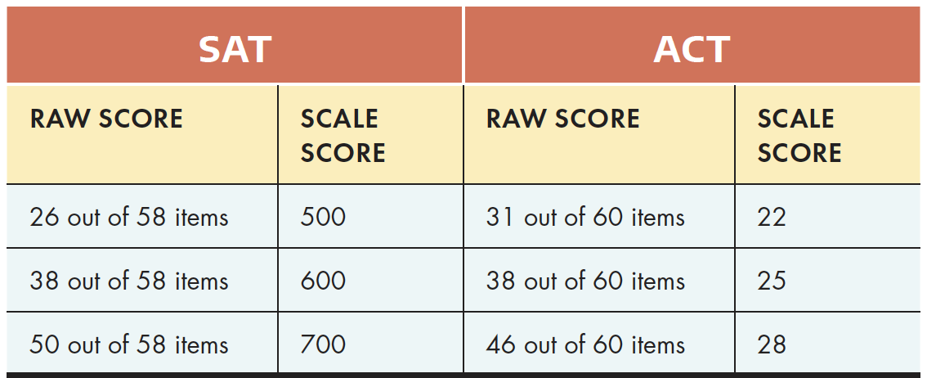
SAT and ACT Raw Score Realities

Slide 17
In other words:
We are taking this on to address a range of very clear and very real challenges.
“Hey world: the status quo in high school math is simply unacceptable.”

Slide 18
The excuses we make are legion
They don’t have the basic skills – But…
They just aren’t motivated – Well duh…
I’ve got to prepare them for the tests – Yes, but DOK 2 and 3
But it’s what colleges demand – Changing rapidly
There just isn’t enough time – YES!
My textbook guides what I do – Yeah, but…
I don’t have the technology needed to change what I do – Why not?
I don’t have the training –AMEN!

Slide 19
So the challenges are real and massive.
Some excuses ring hollow, others are very real.
The status quo is simply unacceptable.
But: we have sensible guiding principles upon which to draw.

Slide 20
14 Guiding Principles
Chapter 3 available for free download at https://samplechapters.heinemann.com/invigorating-high-school-math
Goals and Purposes – a shared, written and honored set of goals to guide decision-making, policy and program.
Vision – a descriptive and explicit vision of effective teaching and learning.
Equity and Access – an assurance of access to quality curriculum and teaching.
Culture – a culture of mutual respect and collegial collaboration.
Scope – a focus on the essential ideas and processes of math.
Differentiation – a common core of essential mathematics differentiated by life and career goals.
Integrated Math – a recognition that math is a unified body of knowledge about quantify, change, uncertainty, shape and dimension.

Slide 21
Guiding Principles (continued)
Content and Process Standards – a program driven by standards or expectations that inform course and unit learning goals.
Connections – an explicit and coherent exploration of how ideas relate.
Context and Modeling – an inclusion of situations, applications, contemporary problems that illustrate the power and usefulness of math.
Assessment – a recognition that assessment is an integral part of instruction.
Technology – a full uses of the technologies that increase the productivity of instruction
Adequate Time – it’s incredibly hard to do in less than one hour each day.
Professional Growth and Collaboration – an intensive focus on professional growth and collaboration among teachers

Slide 22
Guiding Questions
So Chapter 3 is freely available at:
https://samplechapters.heinemann.com/invigorating-high-school-math
Start a discussion after reading the chapter with:
1. Of these fourteen domains, which ones do you think your department comes
closest to meeting? In what ways is this the case?
2. Of these fourteen domains, which ones do you think your department is farthest from meeting? Why do you think this is the case? What specific steps can you take to change this?
3. Of these fourteen domains, and given that it is impossible to simultaneously address them all, which two or three do you and your colleagues believe are good places to start?

Slide 23
Converting Principles into Courses
One answer for grades 9 and 10:
Two common, integrated (algebra, geometry, statistics) courses
- Integrated High School Mathematics 1
- Integrated High School Mathematics 2

Slide 24
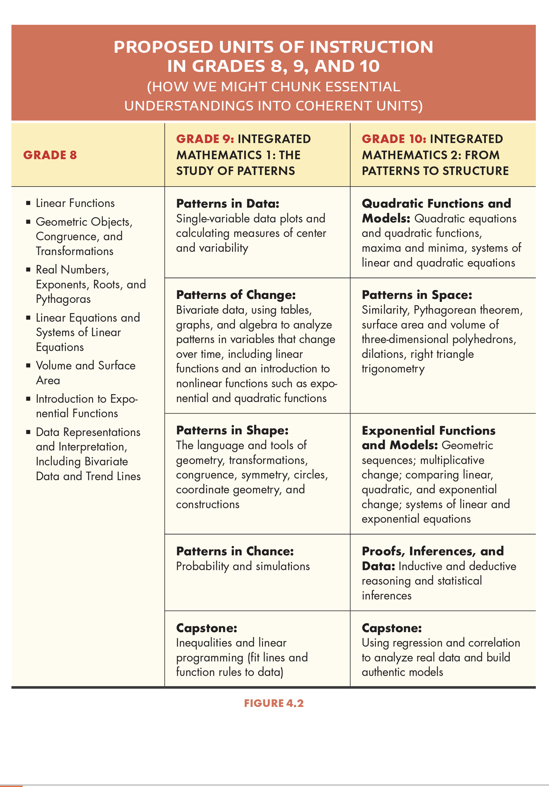

Slide 25
Unit Example

Slide 26
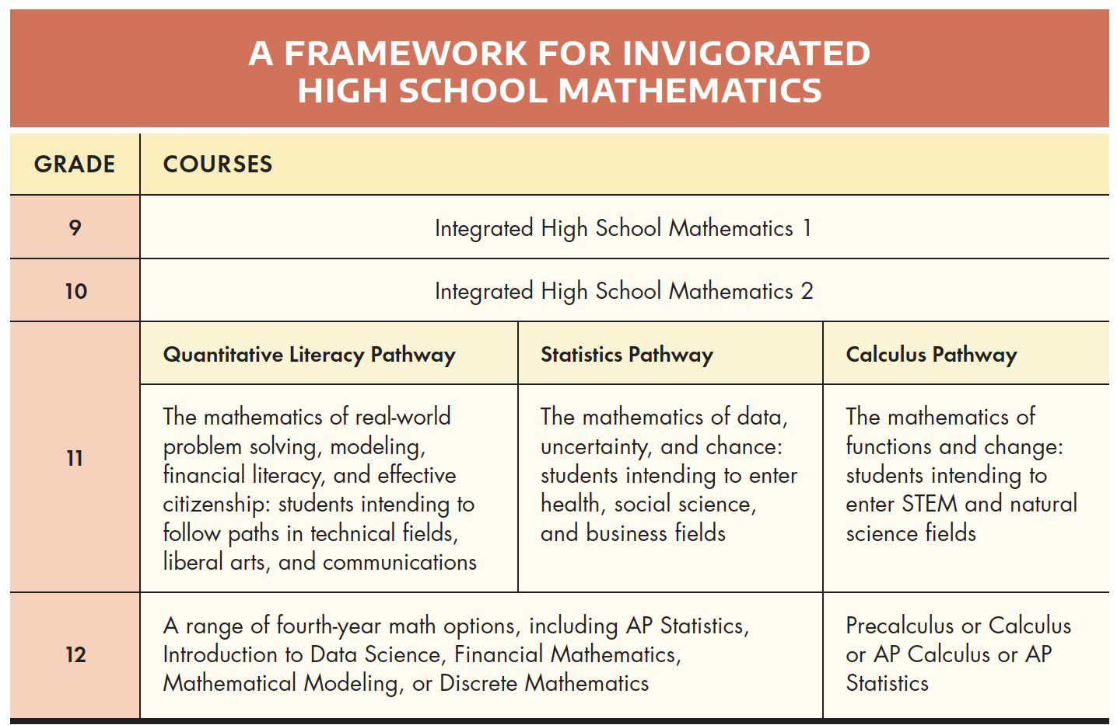
Converting Principles into Pathways
Three Differentiated pathways for relevant, meaningful, appropriate mathematics for grades 11 and 12.

Slide 27
And again, detailed course outlines for each new or nontraditional course

Slide 28
But as we all know, curriculum alone won’t solve our problems.
Implementing these changes in what we teach requires commensurate changes in how we teach and assess and what we focus on:
Pedagogy
Assessment
Technology
Modeling

Slide 29
What we know about change:
Change takes time, but too often we are asked to implement changes prematurely, before getting buy-in and before those who need to do the implementation are adequately trained and ready.
Change begins with informed discussion, but too often the scope of change is imposed without adequate discussion or without building a consensus for change.
Change takes careful planning, but too often insufficient time and resources are allocated to this essential step, resulting in decisions that are imposed, made prematurely, or made without adequate thought to their implications.

Slide 30
What we know about change:
Change takes winning over colleagues and decision makers, but too often we ignore recalcitrant colleagues who undermine change initiatives, we leave administrators having to defend decisions they don’t understand, and we forget that board members will worry that changes will negatively affect their own, or their neighbor’s, children, and we fail to brief all decision makers early in the process and continuously over time.
Change requires mutual trust, a sense of collegiality, and shared purpose that must be built, but too often failure is blamed on recalcitrant teachers who are left uninvolved or uncommitted to the change.
Change requires support, but too often the time, resources, and outside consultative assistance are not forthcoming.
Change requires careful monitoring, nimble revision, and ongoing refinement, but too often change is “one and done,” without a deep understanding that nothing of quality is done in one iteration.

Slide 31
Accordingly, a 5-year implementation plan
Year 1: Review current conditions, read research and build consensus
Year 2: Pilot various shifts and engage in intense planning
Year 3: Initial implementation of one grade 9 and one grade 11 course with close monitoring
Year 4: Implementation of more courses and refinement of Year 3 efforts
Year 5: Institutionalization of invigorated program

Slide 32
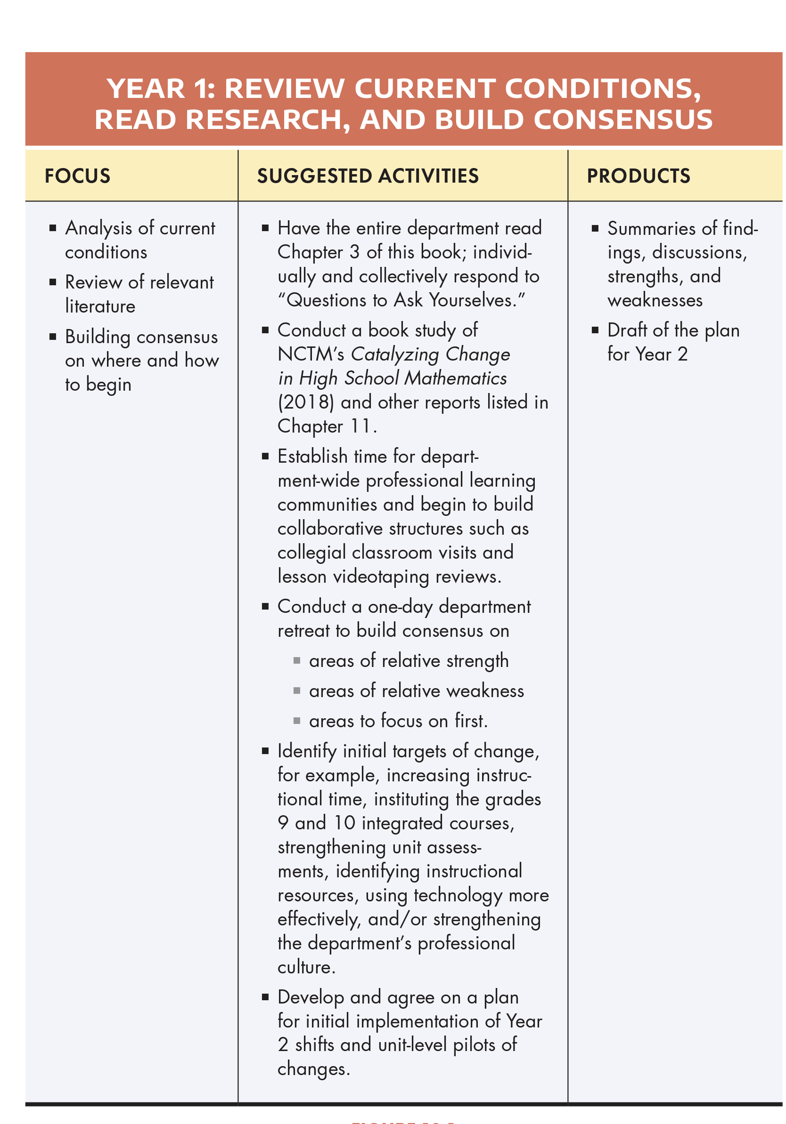

Slide 33
Questions???
Thank you
“The Status Quo is Simply Not Acceptable”

